Slide 1
Global Semiconductor Initiative in the IEEE Future Directions
Tom Coughlin, 2023 IEEE President-Elect
Kathy Herring Hayashi, IEEE Region 6 Director
CASS-Wide Webinar XIII
25 October 2023

Slide 2
The Importance of Semiconductor Chips
Semiconductor chips are an essential component of thousands of everyday devices, such as computers, smartphones, automobiles, appliances, gaming hardware, and medical equipment.
They are also critical to national defense and cybersecurity.

Slide 3
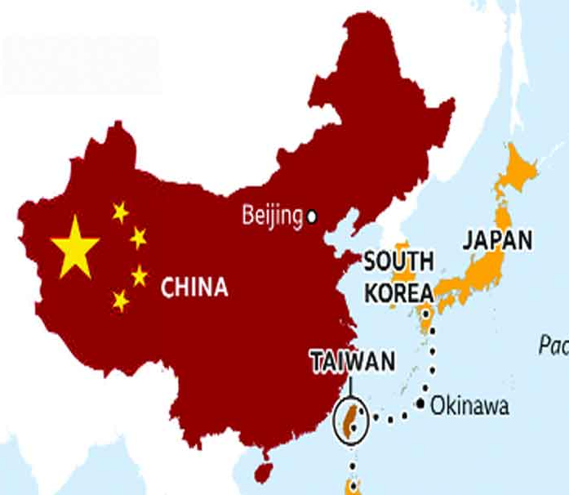
Semiconductor Manufacturing Market Share
75% of all chips are manufactured in East Asia
Taiwan accounts for 66% of this production capacity
Many Asian countries are investing heavily in building additional capacity
The EU also produces only about 10% of the world’s chips
Once a world leader, today the US only accounts for 10% of world chip production

Slide 4
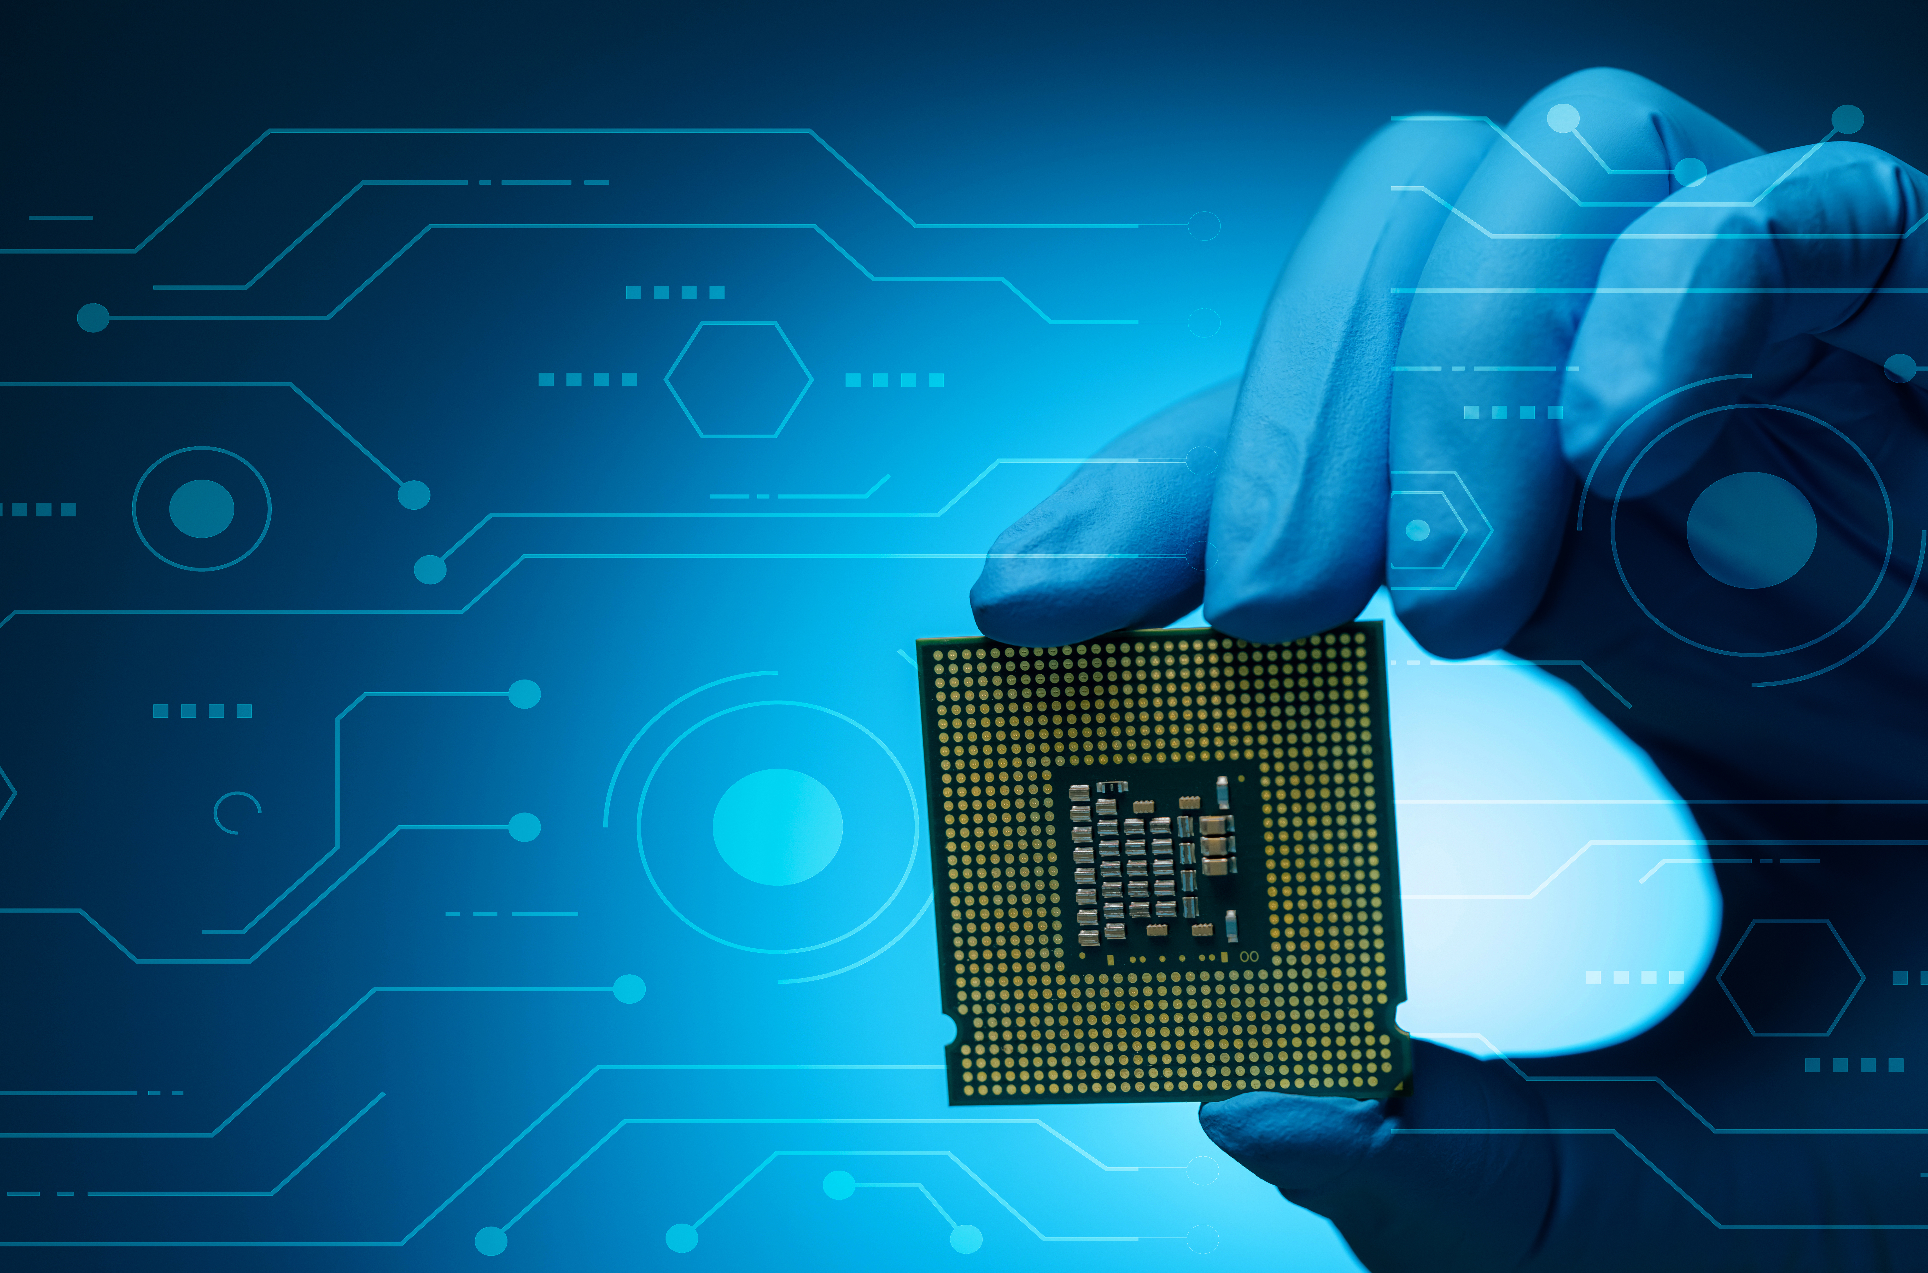
What are the CHIPS Acts?
A global perspective
While the US enacted the first CHIPS Act, which allocates billions of dollars for semiconductor domestic capacity building, other countries are also enacting legislation
NOTE: When we refer to “CHIPS Acts” we are talking about legislation tied to public and private investment happening on a global scale
Each region’s “CHIPS Act” supports the development of indigenous semiconductor manufacturing, supply chain and workforce development
Global Semiconductor Initiative in the IEEE Future Directions:
Identify areas within the global landscape where IEEE may most effectively engage by working across IEEE organizational units and deploying resources strategically

Slide 5
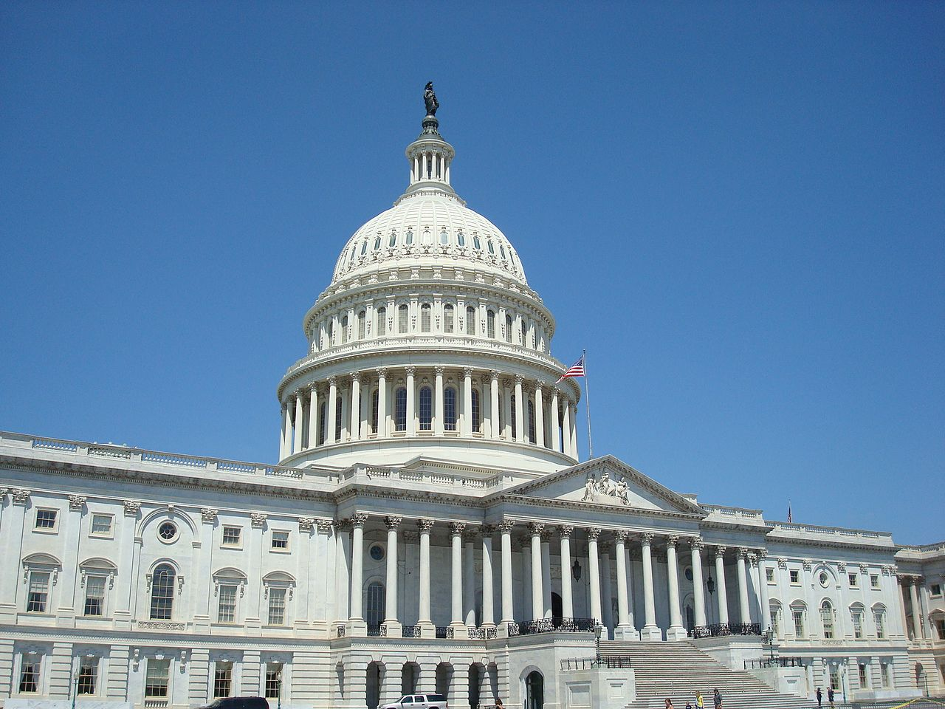
IEEE-USA Led the Way
IEEE-USA was very active in the creation and passage of the CHIPS and Science Act and its precursor authorization legislation
IEEE-USA Efforts continue:
Workforce Training event in Little Rock, Arkansas
STEM Native American community outreach*
2023 Congressional Visits Day
Government Contracts Preparation*
Congressional Advocacy
*

Slide 6
United States CHIPS and Science Act
Signed in August 2022
Provides massive investment in developing chip manufacturing infrastructure and workforce development capacity
Workforce Development Funds
$100 Billion
$52 Billion
Amount allocated for semiconductor research, design, and manufacturing
Amount allocated for National Science Foundation, establishment of regional technology hubs
Federal workforce development funds authorized to train diverse American workers for in-demand semiconductor jobs

Slide 7
Chips for Europe Initiative (EU Chips Act)
Passed in July 2023
Public and private investment plan designed to facilitate technological capacity building and related research and innovation.
€43 Billion
€3.3 Billion
€1.65 Billion
Government investment in technological capacity building, research, and innovation
Horizon Europe commitment for research and innovation, and funding from Digital Europe for capacity-building
Amount expected in public and private investment

Slide 8
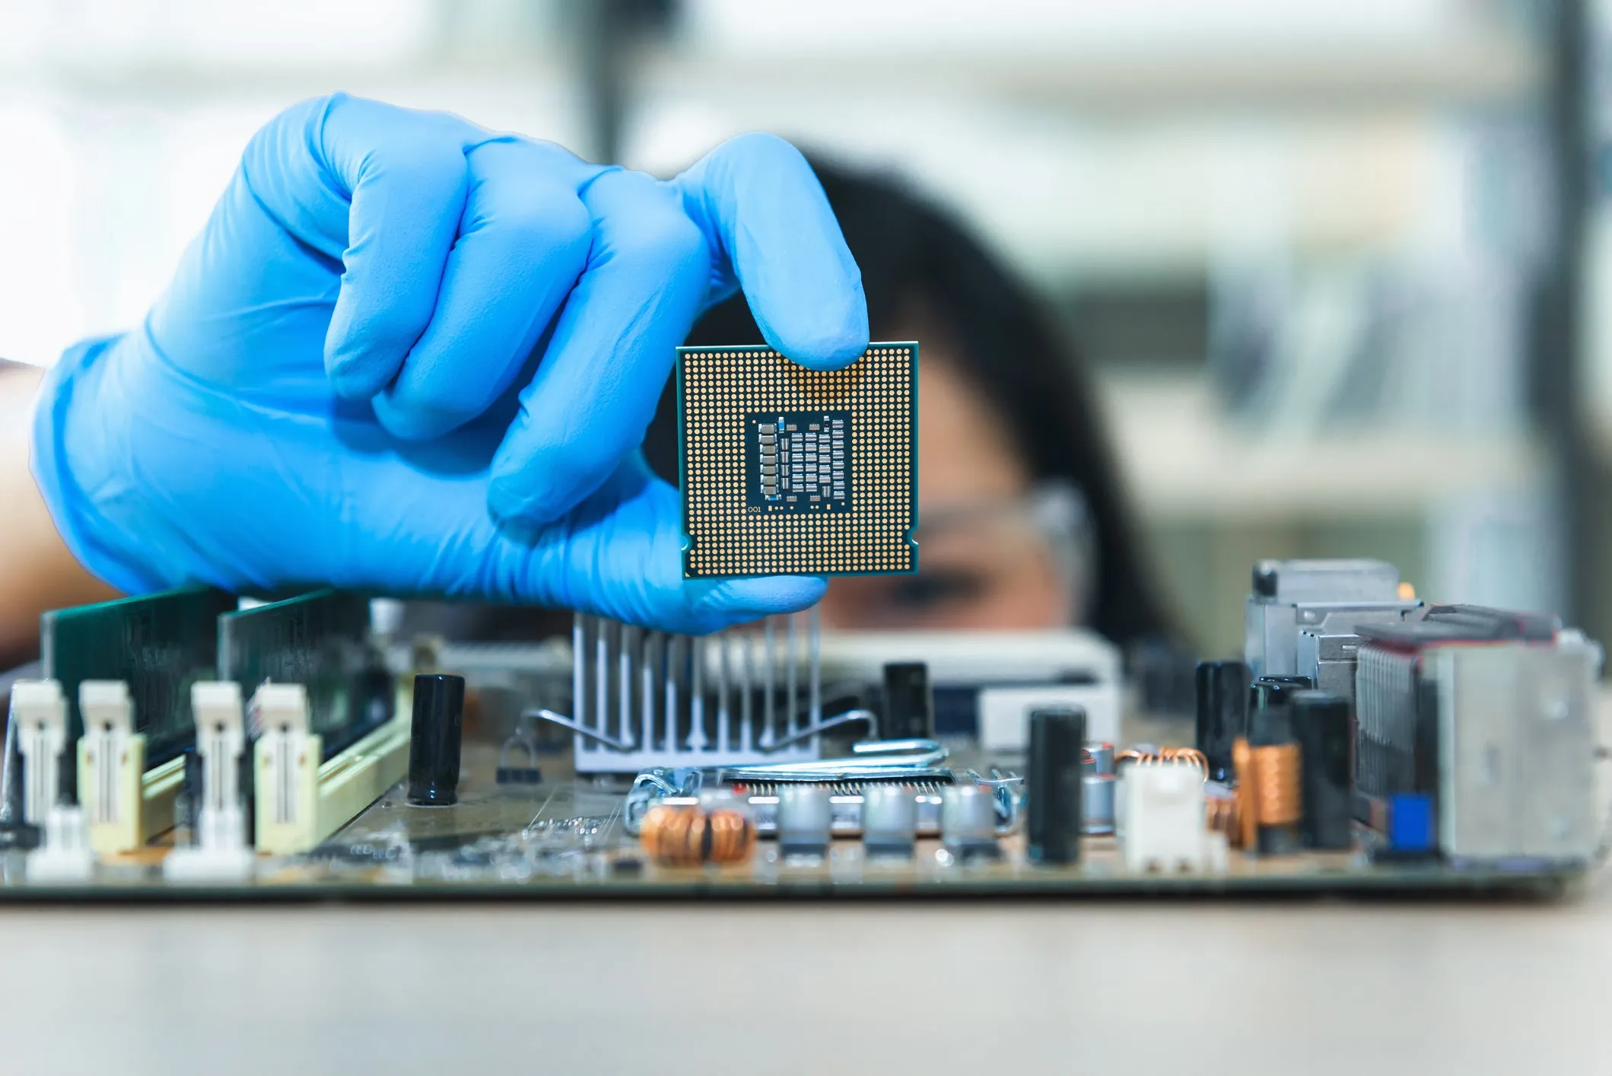
Semiconductor Workforce Development
Currently, there is a severe shortage of trained semiconductor workers
Workers needed span from technicians that don’t require a four-year degree to advanced engineering roles
US Chips Act requires workforce development efforts to include underrepresented communities
Community colleges are mobilizing to provide technician training alongside apprenticeships
IEEE may be able to help upskill current engineers to work in the semiconductor industry

Slide 9
At First Glance: IEEE Areas of Opportunity
Roadmaps
NIST engagement with Electronics Packaging Society and HIR Roadmap
Other roadmaps could be relevant; engage IEEE Roadmaps User Groups?
Society Engagement
Subject matter expertise in Societies such as Electronics Packaging Society, Electron Devices Society, Nanotechnology Council, Instrumentation and Measurement Society, etc.
Workforce Development
Educational Activities courses and credentialing initiatives for workforce development
Formation of the IEEE Global Semiconductor Initiative
MSD semiconductor content collections for researchers and practitioners

Slide 10
IEEE Future Directions
2023 Initiatives Past Initiatives
5G and Beyond Testbed
2019-
Contain “Chips”

Slide 11
IEEE Future Directions: Committees and Ad hoc
IEEE Roadmaps Committee
roadmaps.ieee.org
Evaluate, recommend, implement Technical IEEE Roadmaps
Four published, others under construction
Published roadmaps
IEEE Global Semiconductor Ad Hoc https://semiconductors.ieee.org/
- Evaluate, recommend, implement opportunities for IEEE Global Semiconductor engagement
International Network Generations Roadmap (INGR)

Slide 12
Semiconductor Courses and Microcredentials
Exploring workforce development course offerings that would help upskill working engineers for semiconductor careers and microcredentials that certify proficiency
Action: If your organization would like to provide input or partner with IEEE on this project, please contact Jennifer Fong, Director of Continuing Education Products and Business Development, at j.fong@ieee.org

Slide 13
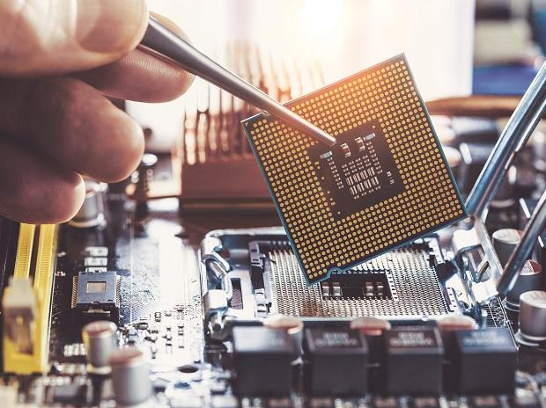
IEEE Global Semiconductor Ad Hoc
Ad hoc formed under IEEE Future Directions
Chairs:
Tom Coughlin, IEEE President-Elect
Kathy Hayashi, R6 Director
Objectives:
Inform – Create website with links and information related to global semiconductor initiatives and related programs
Engage – Identify opportunities for IEEE members and groups to expand their reach with the initiatives and guide industry advancements
Support – Support overall involvement in the industry including DEI for industry professionals and STEM for encouraging the future workforce

Slide 14
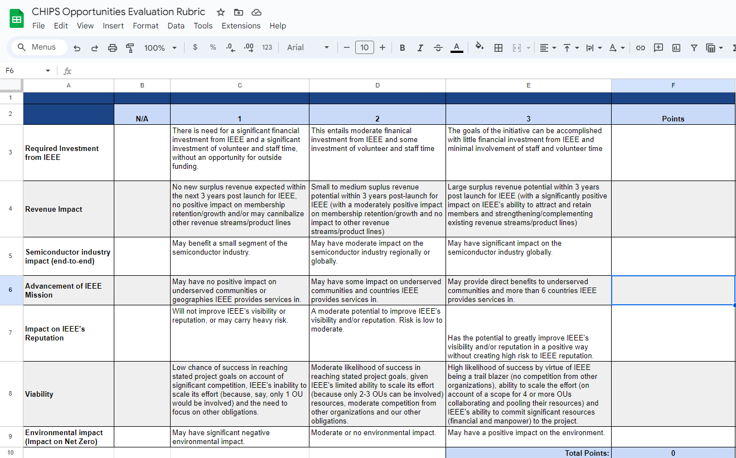
Project Evaluation Rubric
Designed to help establish priorities for IEEE engagement/resources in semiconductor activities
There are many ideas and many things we could do as IEEE
To help us identify the areas where IEEE might have the most impact, the team is developing a rubric to evaluate ideas
Areas to consider include:
Required investment from IEEE (time and money)
Revenue impact
Semiconductor industry impact
Advancement of IEEE mission
Impact on IEEE reputation
Viability
Environmental impact (Impact on Net Zero)
https://docs.google.com/spreadsheets/d/1YCHNfCX6CLrtbbXYUMZNs_oEgGYTCk2HdqRKkTKKoKE/edit?usp=sharing

Slide 15
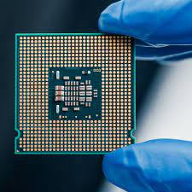
CHIPS Industry Advisory Panel
A discussion with the semiconductor industry hosted by IEEE-USA on 17 April 2023
Eight major organizations involved with the semiconductor industry discussed:
How IEEE could meaningfully engage in the response to CHIPS legislation
What their organizations need help with
Key outcomes/takeaways:
Workforce development is a pressing need
A database of skills and knowledge for workers in the industry is needed for operators, technicians, and engineers
Universities need an update to microelectronics and semiconductor curricula
At least 2x the number of industry workforce participants (all levels) are needed in the near future
There is a huge need to engage and support women and other underrepresented groups to gain and retain enough workers to support the industry
We need to make students aware of the semiconductor industry as early as grade school
IEEE could provide experts/speaker to school systems to talk to students about the benefits of hardware and semiconductor engineering
Guidelines to help smaller companies access CHIPS funding would be extremely valuable

Slide 16
Volunteer Virtual Panel Discussion: CHIPS Acts Opportunities
Virtual Panel held 21 June 2023
An opportunity for IEEE members to consider global CHIPS Acts/Semiconductor opportunities for IEEE
Moderated by President-Elect Tom Coughlin
Panelists were IEEE members with deep expertise in semiconductor-related fields, including:
Bill Chen
Matt Francis
Kathy Herring Hayashi
Kathleen Kramer
Rakesh Kumar
Tim Lee
Dejan Milojicic
Jeewika Ranaweera

Slide 17
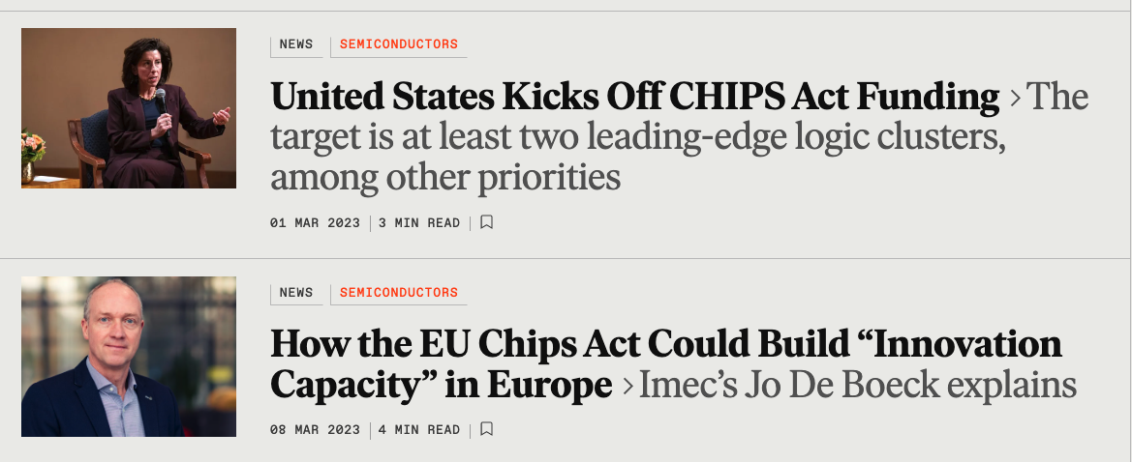
Other Engagement
Exploring new business and Xplore content sets
Coverage in IEEE Spectrum
Pairing IEEE Jobs Site posts with semiconductor coverage
Future Directions authoritative CHIPS Act article
Semiconductor STEM resources on IEEE TryEngineering (in partnership with SEMI Foundation)
Reaching out to groups like SEMI, SEMI Foundation, NSF, etc.

Slide 18
IEEE Global Semiconductors Website Launched
semiconductors.ieee.org
Common repository to expose content and activities in the space specifically related to the CHIPS Acts and semiconductors
Focus areas include workforce development, addressing supply chain issues, and fostering the discussion globally

