Slide 1


Webinar
Universalization in IC Design by CASS (UNIC-CASS)
Focused Lecture
Aug 16th 2023, 09:00am EDT
Moderator: Fakhrul Zaman Rokhani,
IEEE CASS VP-Education and Communications

Slide 2
Agenda
9.00 -9.05: Welcome & Introductions (Fakhrul Zaman Rokhani, VP Education & Communications)
9.05-9.10: UNIC-CASS 2nd Edition Program Overview (Jose De La Rosa, UNIC-CASS Project Sponsor)
9.10-9.30: Education in UNIC-CASS (Dui-Hieu Bui, UNIC-CASS Team Lead)
9.30-9.40: Mentoring Design-to-Tapeout (Jorge Marin, UNIC-CASS Team Lead)
9.40-9.50: Chip Test/Bring-up (Yongfu Li, UNIC-CASS Team Lead)
9.50-9.58: Q&A
9.58-10.00: Closing Remarks

Slide 3
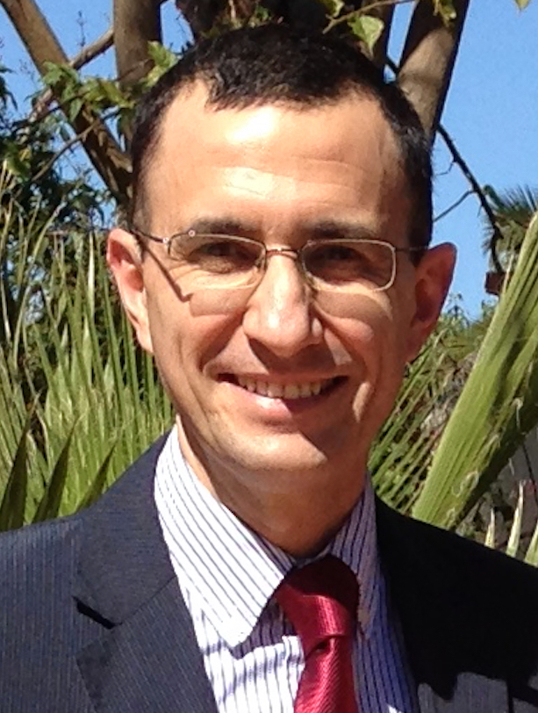

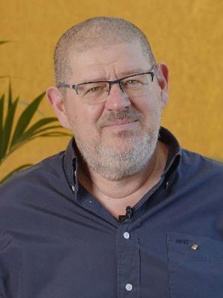
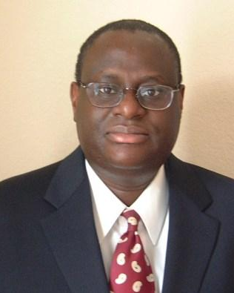
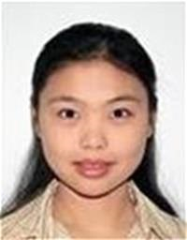
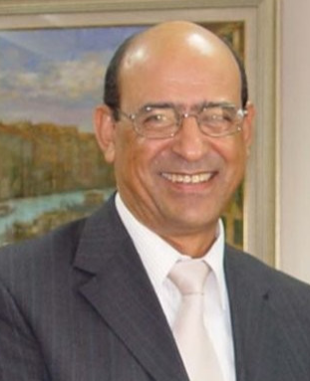

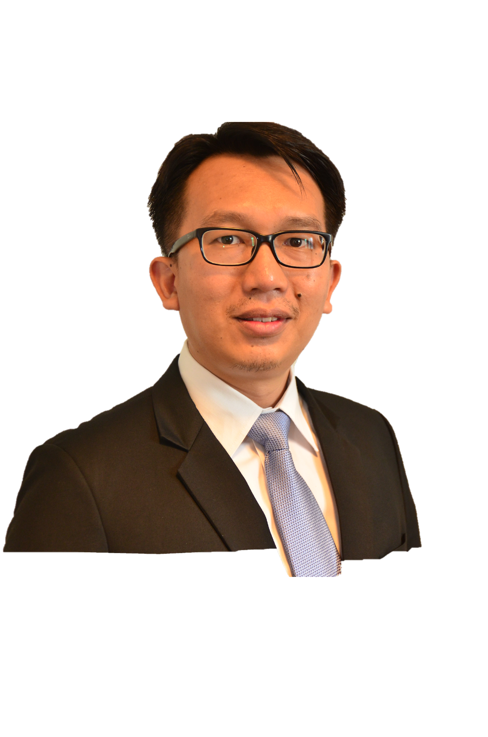
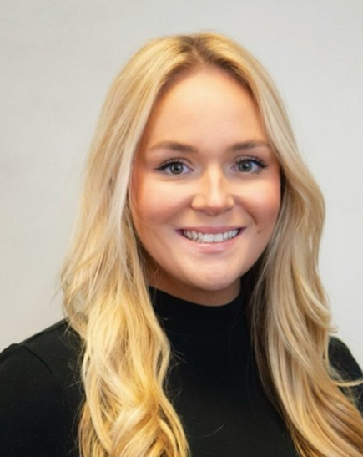
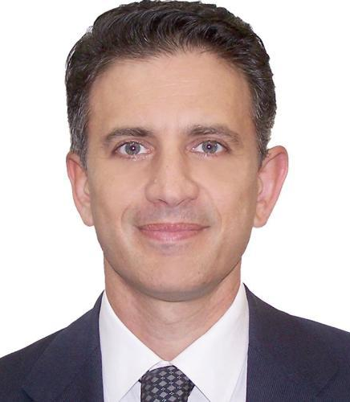
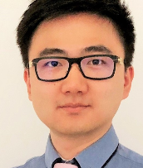
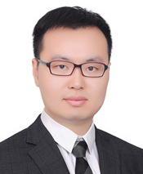
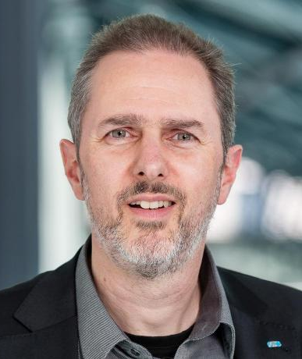
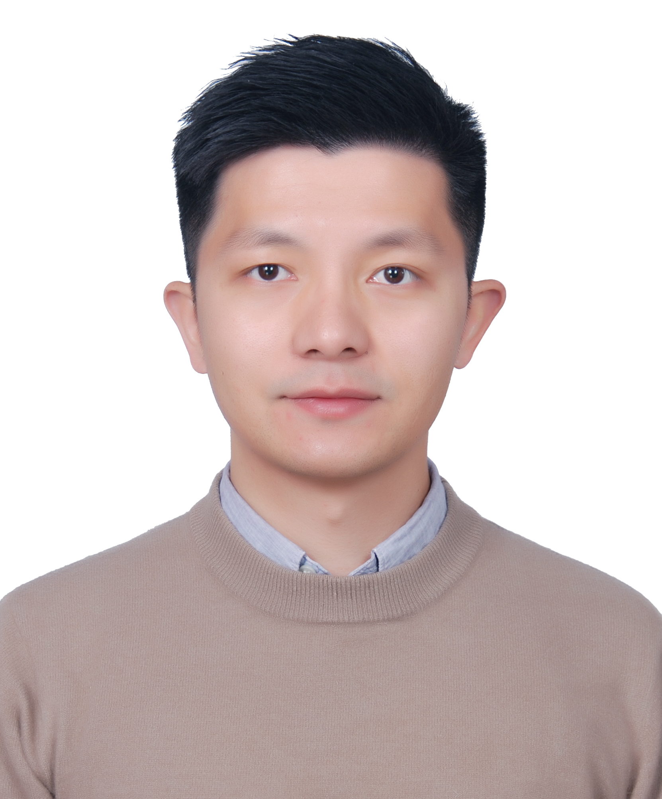
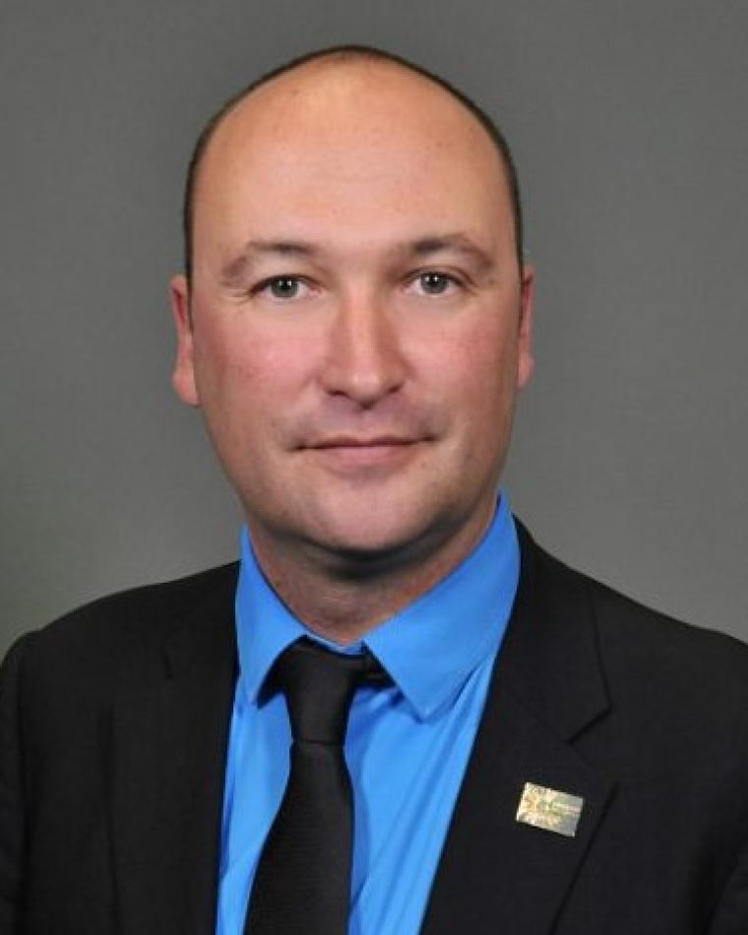
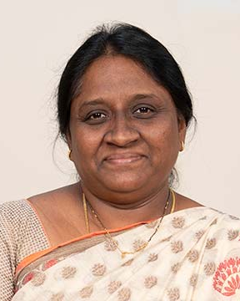
Who’s Who in Education @ CASS 2024
Education Standing Committee
José M. de la Rosa
Victor Grimblatt
Sorin Cotofana
Tokunbo Ogunfunmi
Tong Ge
Amara Amara
Andy
Wu
Fakhrul Zaman
Rokhani
VP Education & Communications
Institute for Global Education
Molly Bracklin
CASS Manager
Massimo Alioto
DL Selection Committee Chair
2023 - 2025
Victor Grimblatt
IDL Selection Committee Chair
2024 - 2025
Fakhrul Zaman Rokhani
Seasonal School /
CASS Microlearning
Yu Wu
Mentoring
Program
Jian Zhao
CASS-wide
Webinar
Marco Winzker
FPGA Remote Lab
Yuxuan Luo
Career Center
Francois Rivet
Continuing Education
Santhosh Miriala
CASS Blitz
Notes:
https://ea.ieee.org/ea-board/meeting-agendas-minutes
Consolidate program – Internalize volunteers - Scale

Slide 4

CASS Institute for Global Education
GOAL
To become a major resource of choice for learners in all educational matters within CASS’s fields of interest.
LEARNERS
Engineering and scientific community, and the general public in educational pursuits:
Members
Students (pre-univ, Univ/college, post-grad)
Practitioners (Young professionals, Seasoned Professionals)
Educators
Retirees

Slide 5



PRODUCTS/SERVICES TO MEMBERS (2024)
DLP
industry-DLP
Seasonal School
CASS-wide Webinar
CASS Resource Center
CASS Microlearning
IEEE Learning Network
Experiential Learning in FPGA Design
UNIC-CASS
CASS Blitz
Mentoring Program
Continuing Education @ Selected Conference
Career Center(Launching soon)
Benefits learning with IEEE CASS
Earn credentials - Digital badges sharable on LinkedIn
Educational credits (PDH/CEU)
Certificate of Completion
Job/Graduate Student Opportunities (Launching soon)

Slide 6

2023 IEEE EAB Society/Council Professional Development Award
IEEE Circuits and Systems Society’ is exceptional achievement is recognized with the following citation:
for the development of comprehensive, inclusive, and personalized education for members, the engineering and scientific community, and the general public

Slide 7
Today’s Event
Free and open-source software has and continues to revolutionize our society
Growing movement proliferate to the open access to IC design tools and silicon fabrication
CASS has vested interest in supporting these activities and community building in democratizing (and universalizing) IC Design for enthusiasts and design communities worldwide
This meeting features CASS’s new educational initiative supporting this movement

Slide 8
UNIC-CASS 2nd Edition Program Overview
Presented by:
Jose M De La Rosa
Institute of Microelectronics of Seville (IMSE)

Slide 9
Universalization in IC Design by CASS
(UNIC-CASS)
For more information, visit: https://ieee-cas.org/universalization-ic-design-cass-unic-cass
What is the UNIC-CASS?
A structured end-to-end Integrated Circuit (IC) design-to-test experiential learning program. strategic cooperation with the SSCS serving geographical-complementing locations.
Aim:
To improve the know-how and accessibility to IC Design technologies for enthusiasts and design communities worldwide
How it works?
      Learn: Jumpstart your journey from carefully curated materials on CASS MiLe platform
      Design: Hands-on design mentoring by experts in the field,
      Fabricate: Submit designs to CASS-sponsored fabrication runs via Efabless chipIgnite program
      Test: “Bringup” your fabricated chip at selected testing facilities.
Benefits:
Learn by experience from IC to chip test/bring-up.
Discover using open-source EDA tools and Open PDKs.
Enhance students' professional careers
Material available in GitHub ( github.com/unic-cass ), slack channel (https://unic-cass.slack.com/ ), CASS Microlearning (https://ml.ieee-cas.org)
Notes:
What is UNIC-CASS (Aim, Synergy with SSCS, Benefit)
UNIC-CASS Calendar
The program (Education, Mentoring, Chip bringup)
2023 UNIC-CASS submission
Whos’ who in UNIC-CASS

Slide 10
UNIC-CASS 2nd Edition Calendar
Date | Activity
June 19th, 2024 | First Call for Participation
July 28th, 2024 | Deadline for Proposal submission
Aug 8th, 2024 | Result announcement
Aug 12th – Nov 2024 | - Learn from specially curated educational materials - Design-to-Tapeout Mentoring sessions
Nov 11, 2025 | Deadline for Layout submission (ChipIgnite)
April 2025 | Chip test/bring-up

Slide 11
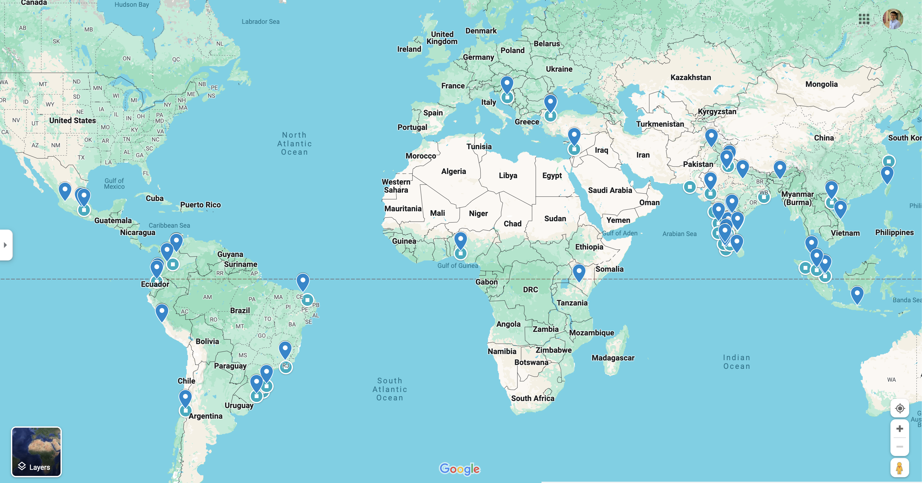
2024 UNIC-CASS submission
2023 UNIC-CASS submission
2024: 80 submissions, 19 Countries
2023: 68 submissions, 16 Countries
2023: 68 submissions, 16 Countries

Slide 12
2024 UNIC-CASS 2nd Edition submission
Please shoutout in your social media about this program.
Use hashtag #UNIC-CASS #CASS75 #IEEECASS
Submission
80 TEAMS, 19 Countries
Accepted
42 TEAMS, 17 Countries

Slide 13
Whos’ who in UNIC-CASS
Project Sponsor: Jose De La Rosa (University Sevilla, Spain)
Education Team
Duy-Hieu Bui (Lead), Vietnam National University
M. B. Ghaznavi-Ghoushchi, Shahed University Iran
Dimitri Galayko, Sorbonne Université France
Noor Ain Kamsani, Universiti Putra Malaysia
Suhaidi Shafiee, Universiti Putra Malaysia
Mohd Amrallah Mustafa, Universiti Putra Malaysia
Lini Lee, Multimedia University Malaysia
Azrul Ghazali, Universiti Tenaga Nasional Malaysia
Haslina Jaafar, Universiti Putra Malaysia
Donnacha Lowney, South East Technological University, Ireland
Design-to-Tapeout Mentoring
Jorge Marin (Lead), UTFSM Chile
Sergio Bampi, UFRGS Brazil
Rodrigo N. Wuerdig, UFRGS Brazil
Fernando Silveira, Universidad de la República Uruguay
Pablo Petrashin, Universidad Católica de Córdoba Argentina
Victor Grimblatt, Synopsys Chile
Ricardo Reis, UFRGS Brazil
Sahil Shah, University of Maryland USA
Nicole McFarlane, University of Tennessee USA
Aloke Das, Alten Calsoft Labs India
Miguel Corvacho, Intel USA
Chip Test/Bring-up
Yongfu Li (Lead), Shanghai Jiao Tong University, China
Rajesh Chandrasekhara, National Unviersity of Singapore
Qi Liang, Shanghai Jiao Tong University, China
Xiaochen Tang
Xinfei Guo, New Mexico State University USA

Slide 14
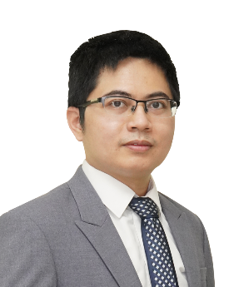
Universalization of Integrated Circuit Designs in CASS (v2.0)
A microlearning course
Presented by:
Duy-Hieu Bui
Information Technology Institute,
Vietnam National University, Hanoi

Slide 15
UNIC-CASS Education Introduction
Main roadblocks for
Design & Education
UNIC-CASS companion course:
Integrated Circuit Design using Open-Source Tools and PDKs
A Jumpstart with opensource tools & PDKs
Videos with updated lecture notes for current PDKs & tools
Simplifying EDA tool & PDK installation
Open MPW or Chip Ignite fabrication
Guidelines & design examples
Learning path for Digital & Analog
ASIC
RTL/IP libraries
PDK Data
EDA Tools

Slide 16
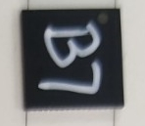
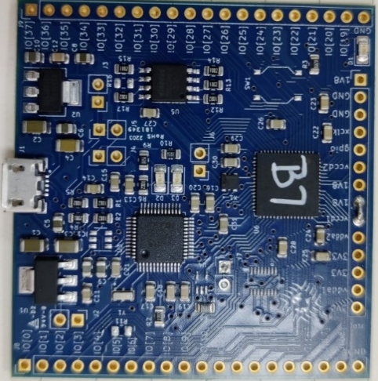
Design a chip in less than 3 months
VCO-based ADC example: mixed-signal design from scratch
Made possible by Opensource EDA tools & PDKs
early, 2021
April, 2021
June 18, 2021
June 24, 2021
Feb., 2022
Heard about Google Open MPW & got intereted
Call for Google Open MPW-2 submission
Form a team & decided to submit VCO-based ADC
Submit the design for Google Open MPW
Get sponsored by SSCS PICO program
Receive the chips & testboard
Project repository: https://github.com/duyhieubui/caravel_vco_adc

Slide 17
Open PDKs
Open-source PDK repository
Standardizing open-source PDKs for Open-source tools
Skywater 130 PDK
  sky130_fd_sc/pr
  Standard cells: hd, hdll, hvl, hs, ms, ls, lp
  IO cells, SRAM bitcells, SONOS Flash bitcells
  SRAM compiler (opensource)
  ReRAM supports
Global Foundry 180MCU
Open PDKs’ Makefile & scripts
XSchem
…
Magic
Openlane
NGSpice
KLayout

Slide 18
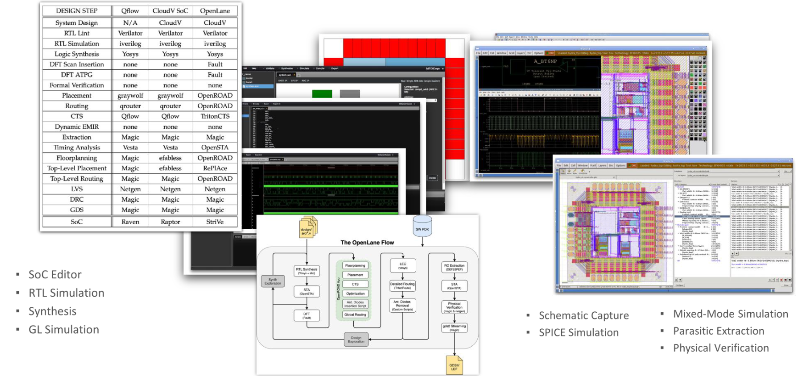
Open SoC Design flows & tools
Source: Boris Murmann

Slide 19
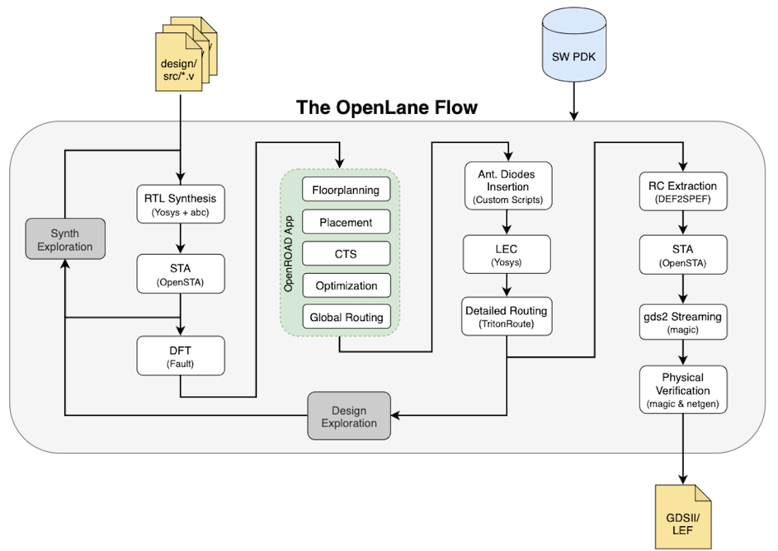
Digital Design flow: RTL-to-GDS
Tool used:
Yosys: synthesis
OpenSTA: timing analysis
Fault: DFT (on-going)
OpenRoad: Backend
Magic/Klayout:
  Layout manipulation
  Debugging
Netgen: LVS

Slide 20
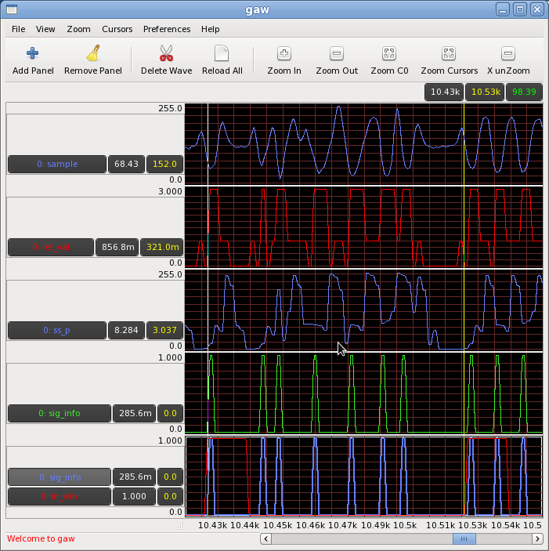
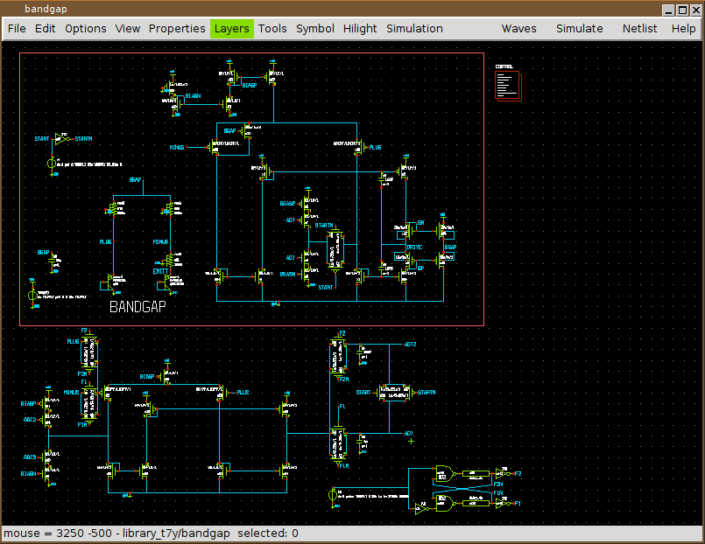



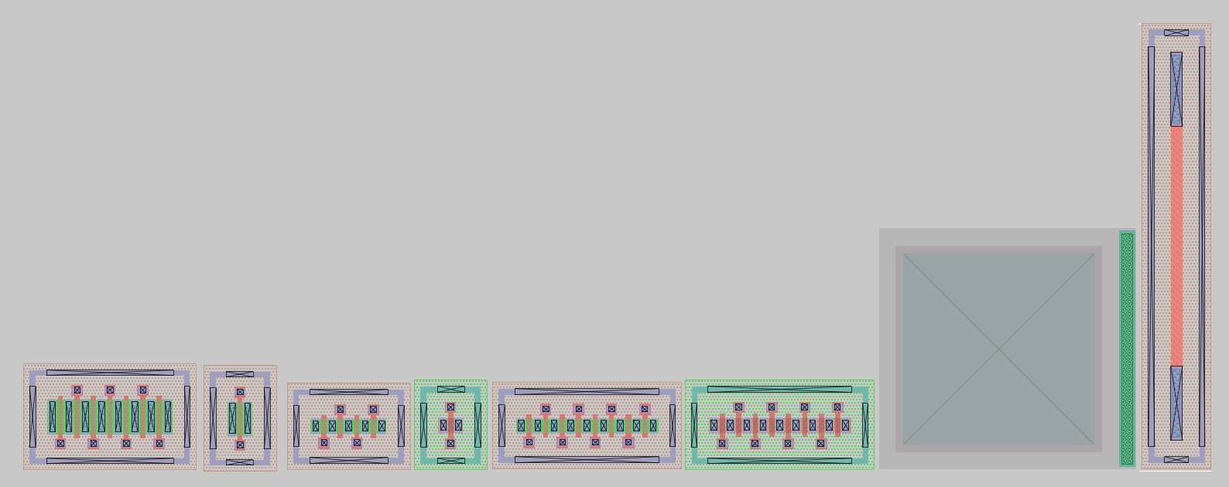
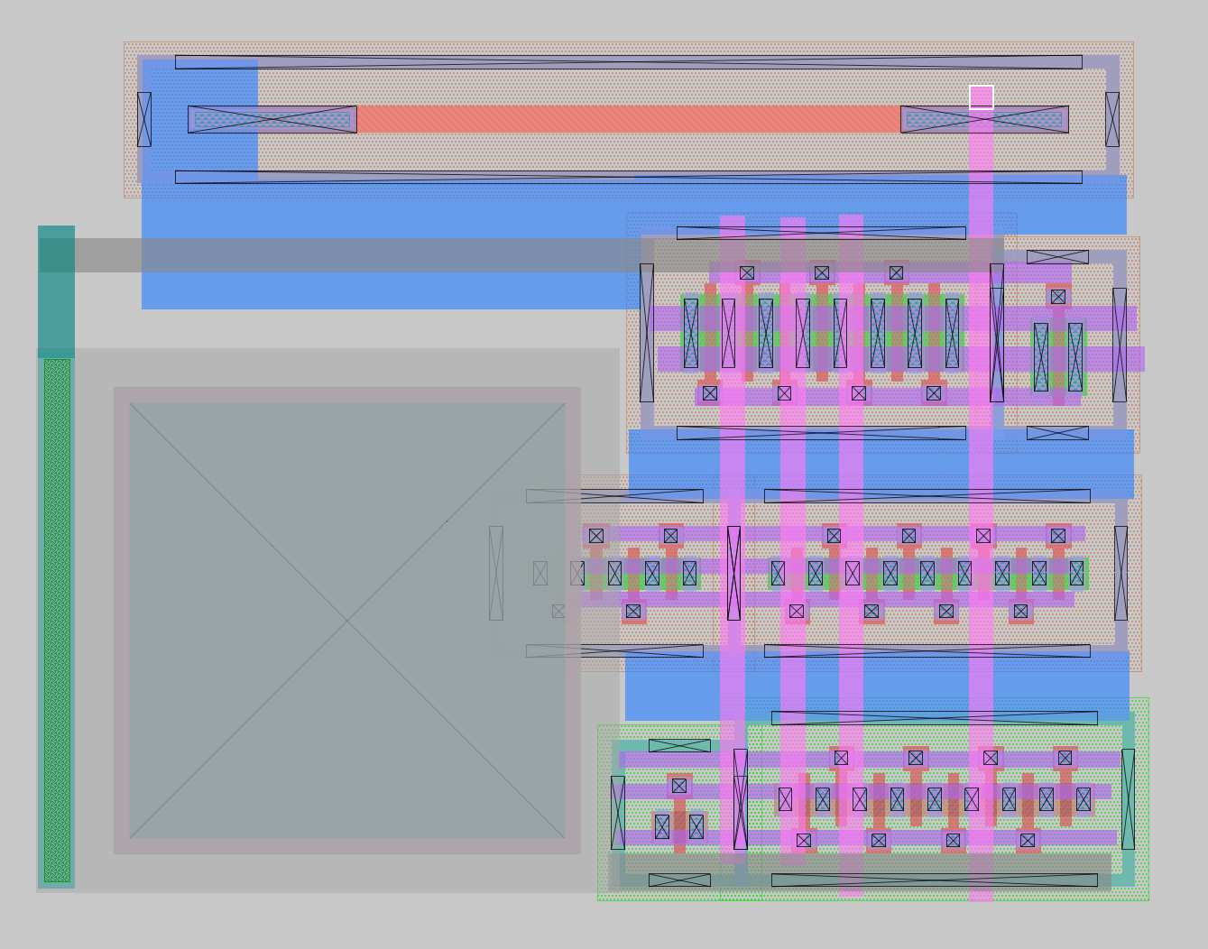
Analog design flow
Netlist
export
Simulate
view
Schematic capture
Ngspice
database
Xschem
Gaw
Generate & Import netlists into Magic
Evaluation & debugging
Layout Vs schematic
Netgen
Pass/fail?
Gaw
export
Simulate
view
Layout & DRC
Ngspice
Netlist
database
Magic

Slide 21

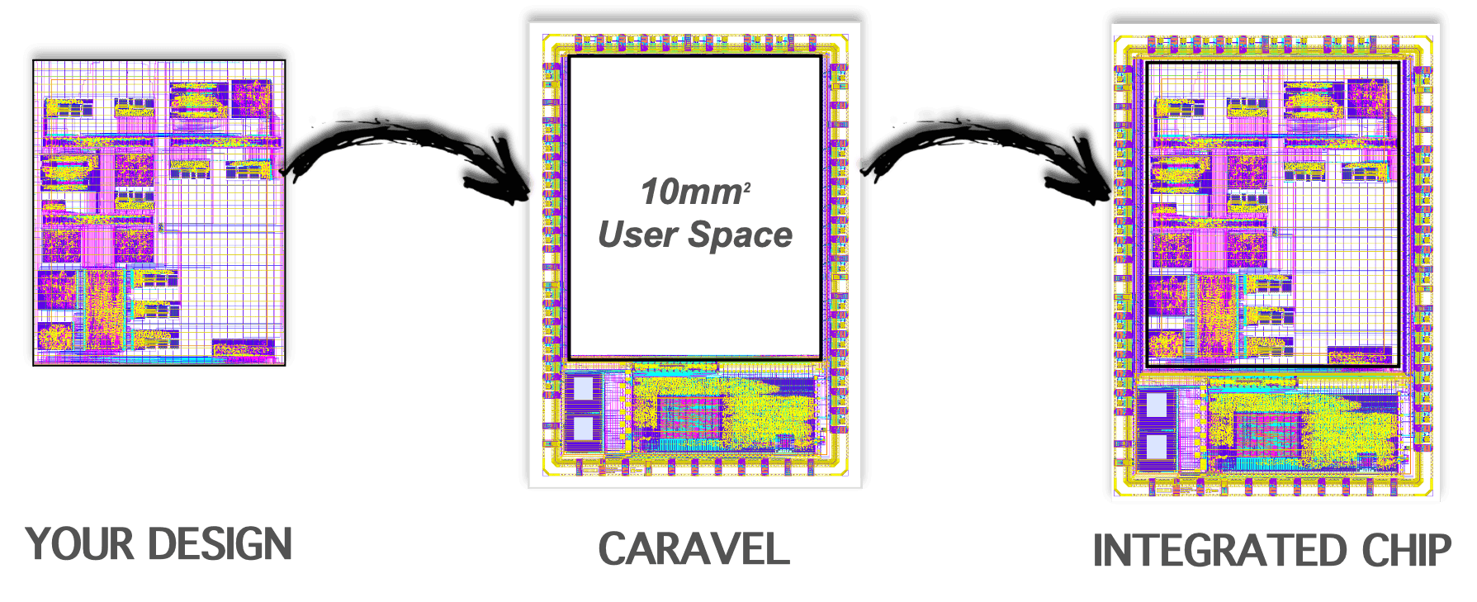
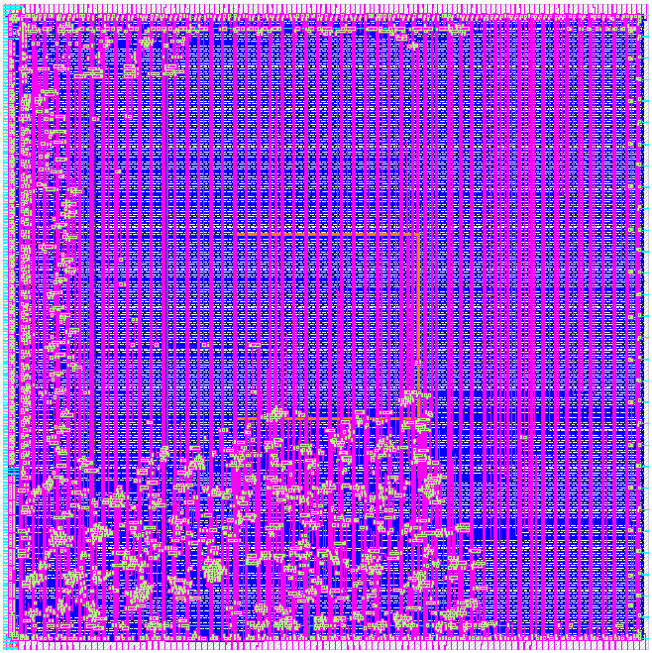
Open MPW/Chip Ignite design focus
Your design
Caravel user project
Wrapper
Harden your design
Integrate your design into user project wrapper
Caravel test harness
Integrated Chip
Run STA &
precheck scripts
Submit your design
& run tapeout jobs
(Efabless server)
Your main task in UNIC-CASS Program
Automated in Efabless flow

Slide 22
Course outline & learning path
Digital Design
Analog Design
1. Course introduction
2. Tool installation & env setup
2.1 Digital design tools using docker
2.2/2.3 AMS design tools on Docker/conda
4. Digital Design flow with Opensource tools
3. Analog design flow with Opensource tools
5. Functional verification (with Caravel)
6. Preparing design for Tapeout
7. Design examples
7.2 Comparator (design & simulation)
7.3 Operational Amplifier (Layout)
7.4 Layout techniques in Magic
7.1 Basic digital design with Caravel
7.6 OpenRAM compiler

Slide 23
Lecture organization
Each lesson contains (either or both):
Lecture notes
          Updated materials with current design flows & tools
Lecture videos
          Cultivated from the public source
          Demonstrate the ideas & steps to execute
Design examples in Jupyter Notebook (coming soon)
⇒Linking among methodologies, design flows and tools

Slide 24
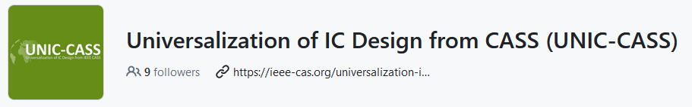
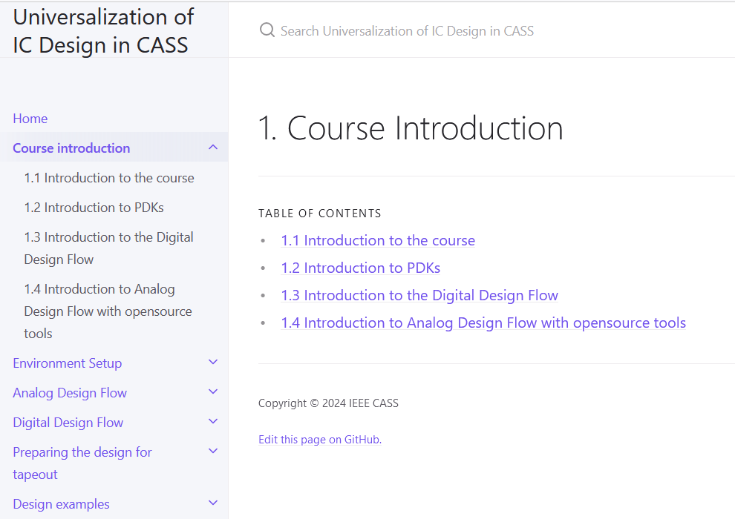
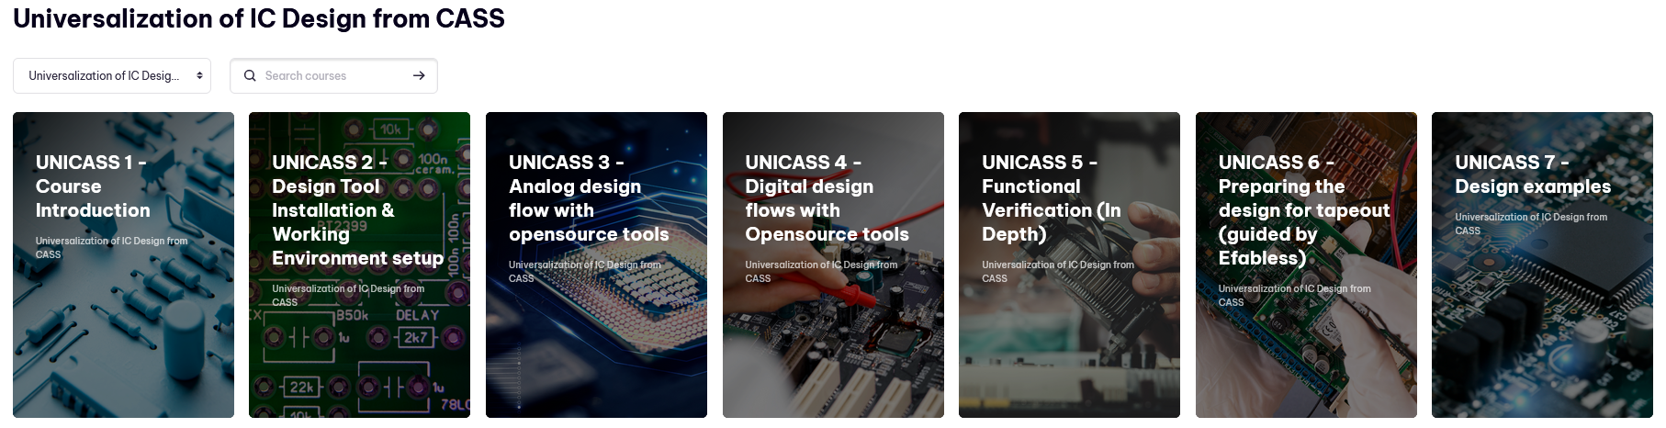
News in v2.0
Source: https://github.com/unic-cass/unic-cass.github.io
New videos made by volunteers following the lecture notes
Lecture notes in Markdown format
  ⇒ You can contribute by updating them
New document theme using Just-the-docs Jekyll theme
Latest materials in Github
Materials in CASS-MiLe will be updated into v2.0 soon
Add instructions for Klayout in analog design flow
          Layout
          DRC
          LVS
Website: https://unic-cass.github.io
CASS-MiLE: https://ml.ieee-cas.org

Slide 25
UNIC-CASS Education Committee
Duy-Hieu Bui, Vietnam National University Hanoi
M. B. Ghaznavi-Ghoushchi, Shahed University Iran
Dimitri Galayko, Sorbonne Université France
Noor Ain Kamsani, Universiti Putra Malaysia
Suhaidi Shafiee, Universiti Putra Malaysia
Mohd Amrallah Mustafa, Universiti Putra Malaysia
Lini Lee, Multimedia University Malaysia
Azrul Ghazali, Universiti Tenaga Nasional Malaysia
Haslina Jaafar, Universiti Putra Malaysia

Slide 26
Special thanks to UNIC-CASS Education Volunteers
Manh Hiep Dao (VNU-ITI, Vietnam)
Duc-Manh Tran (VNU-ITI, Vietnam)
Dinh-Toi Nguyen (VNU-ITI, Vietnam)
Huyen-Trang Pham Thi (VNU-UET, Vietnam)
Hoang-Anh Trinh (VNU-UET, Vietnam)
Thuy-Linh Nguyen (VNU-UET, Vietnam)
Thao-Nguyen Tran-Ha (VNU-UET, Vietnam)

Slide 27
Special thanks to the video authors in v1.0 and a part in v2.0
Tim Ansell (Google)
Tim Edwards (Efabless)
Ahmed Ghazy
Bradley A. Minch
Mohamed Shalan
MattVenn
Jeff DiCorpo
Stefan Schippers
Jame E. Stine
FOSSi Dial-up
Matt Gauthaus
Some other engineers from Efabless

Slide 28
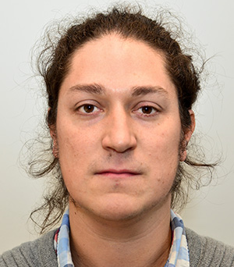

UNIC-CASS Design-to-Tapeout
Presented by:
Jorge Marin
Univ. Tecnica Federico Santa Maria, Chile
Sergio Bampi
Federal Univ. of Rio Grande do Sul, Brasil

Slide 29
Topics
Design-to-tapeout mentoring info and team
Mentoring sessions and milestones schedule
Examples from UNIC-CASS 2023

Slide 30
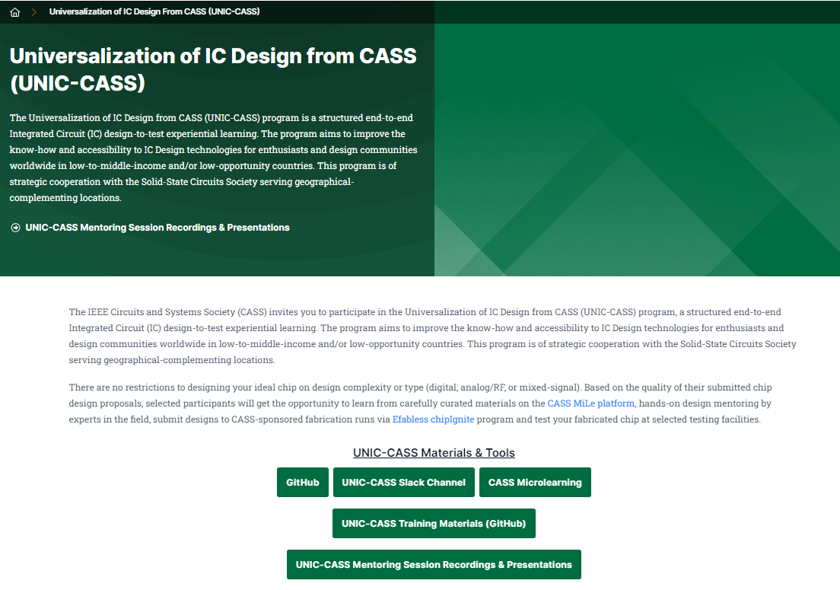
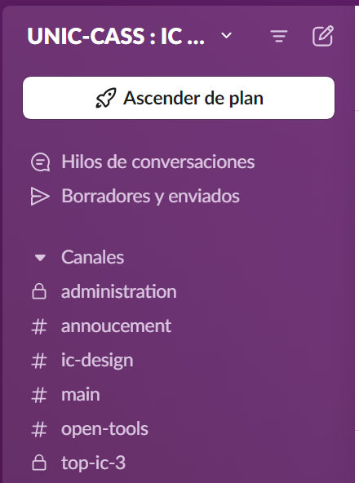
Design-to-Tapeout Mentoring
Communication and organization
Weekly mentoring sessions
Slack Channel
UNIC-CASS website
Recordings and presentations: https://ieee-cas.org/unic-cass-mentoring-session-recordings-presentations
UNIC-CASS Slack channel: https://unic-cass.slack.com/
Notes:
Synchronous weekly meeting + recording
NOTE: weekly is too often, once every two weeks
NOTE: Longer schedule → URGENT

Slide 31
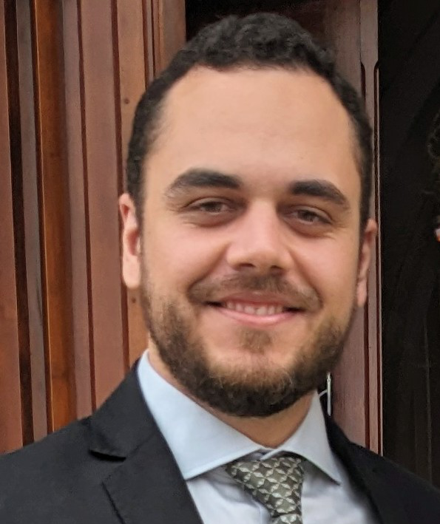

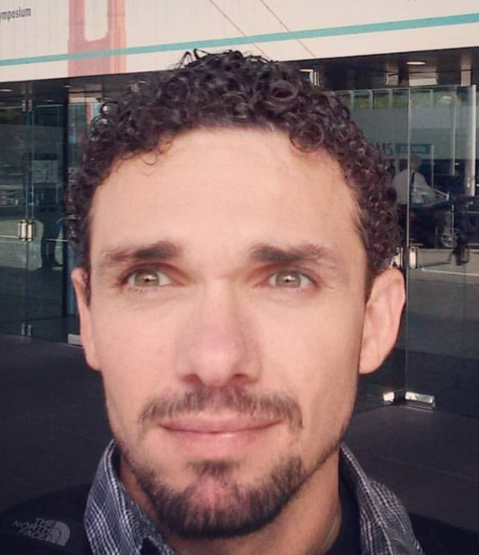

Design-to-Tapeout Mentoring Team 2024
Gabriel Maranhão, UFSC (Brasil)
Deni Alves
UGA (France)/UFSC (Brasil)
Francisco Brito
UFERSA (Brasil)
Rodrigo Wuerdig
KUL (Belgium)/UFRGS (Brasil)
Jorge Marin
UTFSM (Chile)
Sergio Bampi
UFRGS (Brasil)
Notes:
Synchronous weekly meeting + recording
NOTE: weekly is too often, once every two weeks
NOTE: Longer schedule → URGENT

Slide 32
Main Design-to-tapeout milestones
First design review (mock tapeout)
  Purpose: Prepare the teams in advance for the final tape-out phase
  Date: Last week of September
Second design review (first DRC/LVS clean design delivery)
  Purpose: Verify feasibility of designs and top integration
  Date: Second week of October
UNIC-CASS tapeout
  Purpose: final delivery of top designs
  Date: November 8th

Slide 33
Design-to-Tapeout Mentoring
Weekly mentoring sessions 1
Activities | Date/ Deadline | Purpose/ comments | Your Deliverables (provide info/links on your GitHub) | We will provide/handle
1st Meet-up | Aug 12, 1pm-2pm UTC | Kick-off meeting | N/A | N/A
Weekly meet-ups | 21/8,28/8,4/9, 18/9 1pm-2pm UTC | Mentoring and Design groups to present progress. Short presentations on topics such as Caravel/Caravan, best practices, pitfalls to avoid. | N/A | Slides and videos will be posted on the UNI-CASS website
1st Design submission [Mock tape-out] | Sep 25 | Prepare the teams in advance for the final tape-out phase | Passing pre-check report | 1. Detailed instructions for pre-check 2. Example files
1st Design Review & Feedback | Oct 2 | Provide feedback and advice for the next stages | N/A | Feedback on the pre-check work
Weekly meet-ups | 16/10, 30/10, 5/11 1pm-2pm UTC | Focused mentoring + preparation for final tape-out + evaluate status of potential drop-outs | N/A | Slides and videos will be posted on the UNI-CASS website

Slide 34
Design-to-Tapeout Mentoring
Weekly mentoring sessions 2
Activities | Date/ Deadline | Purpose/ comments | Your Deliverables (provide info/links on your GitHub) | We will provide/handle
2nd Design submission | Oct 16 | Verify feasibility of designs and top integration | Detailed circuit description (pinout, area and functionality) + DRC/LVS reports on Efabless platform | Check reports to confirm all blocks are LVS and DRC clean.
2nd Design Review & Feedback from mentors | Oct 23 | Provide feedback and advice for the final stages | N/A | Feedback on the individual designs + advice for top merge
Efabless pre-check + tapeout | Nov 8 | Complete tape-out work on Efabless platform | Deliver COMPLETE Caravel/Caravan drop-ins to Efabless final check | Provide assitance to tape-out leaders within the teams
Tape-out | Nov 11 | See: https://efabless.com/chipignite | N/A | List of winner teams included in this tapeout List of unfinished designs to candidate for 2025 UNIC-CASS program
Chip delivery date | Apr 11 | See: https://efabless.com/chipignite | N/A | Chip shipping and testing logistics

Slide 35
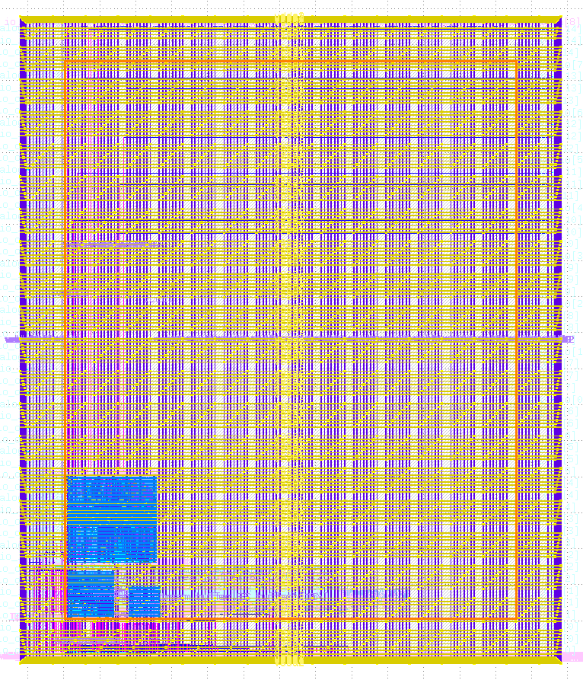
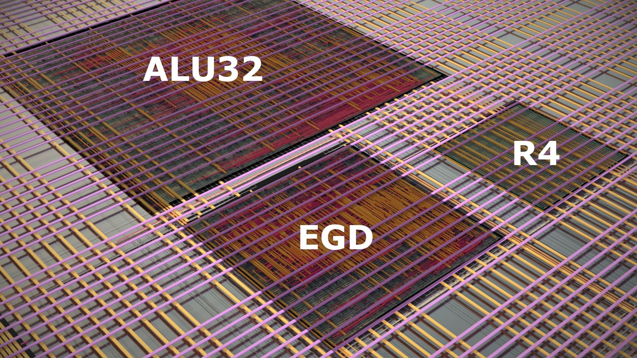
UNIC-CASS 2023 examples
Top-level layout - Digital
Mentor | IP BLOCK | Digital I/Os | Area (mm2)
Yang Lim / (Malaysia) | EGD_top | 35 | 0,0068
Nasri Sulaiman (Malaysia) | R4_Butterfly | 43 | 0,06
C. Diniz / Rodrigo Wuerdig (Brasil) | ALU32b | 72 | 0.1
IC1 – CASS

Slide 36
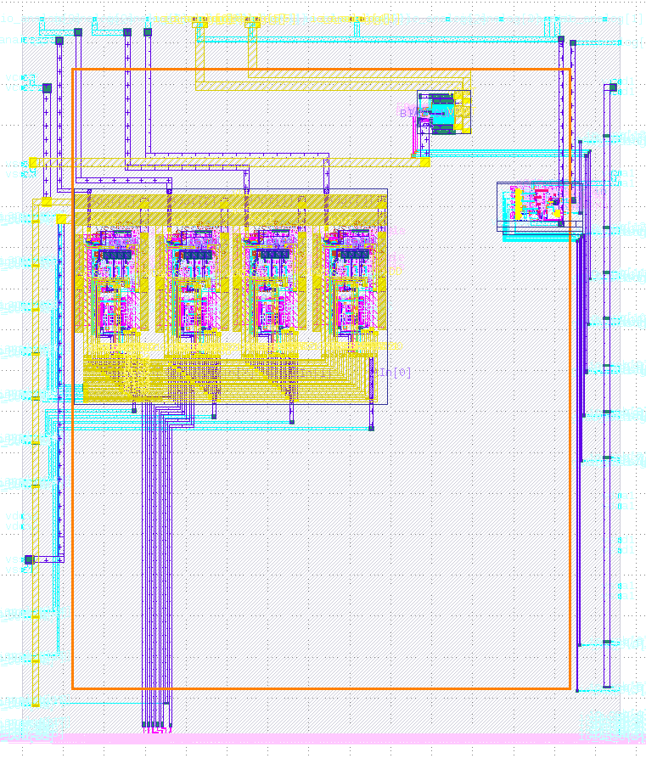
UNIC-CASS 2023 examples
Top-level layouts – Analog/Mixed-signal
Mentor | IP BLOCK | Analog I/Os | Digital I/Os | Area (mm2)
Tran Thuat (Vietnam) | MulColRO | 7 | 7 | 3.0
Alexandar Pajknovic (Bosnia) | Free DAC | 8 (7+1 VDD) | - | 0.64
Naveen Kadaynti (India) | ClipSafe | 14 | 5 | 1.2
IC4 – CASS

Slide 37
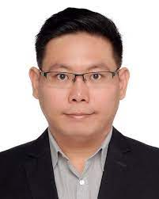
UNIC-CASS Chip Test/Bring up
Presented by:
Yongfu Li
Shanghai Jiao Tong University

Slide 38
What’s Next?
Submit your design
& run tapeout jobs
(Efabless server)
Run STA & precheck scripts
Integrate your design into user project wrapper
Harden your design
Your design
Caravel user project
Wrapper
Caravel test harness
Integrated Chip

Slide 39
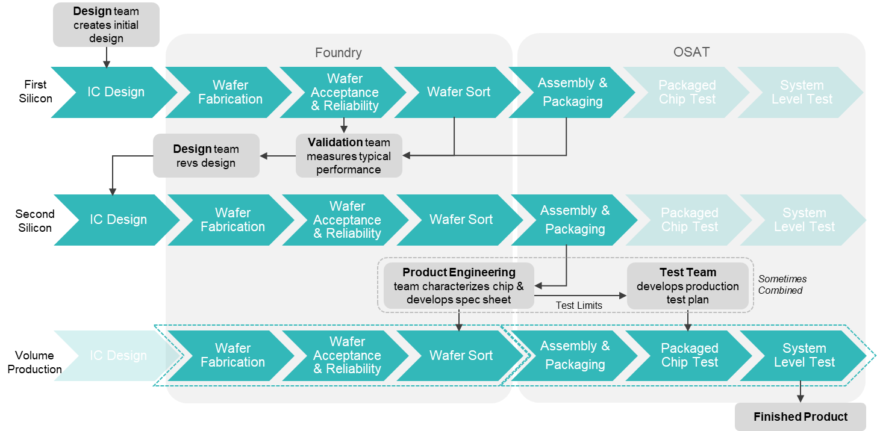

New Chips Get Tested Multiple Times
Knowledge and skill requirements for IC test talents:
Knowledge: The Parameters’ meaning and test methods of test devices
Skills: Test circuit construction
The use of testing and measuring instruments
Test development process
Test program coding

Slide 40
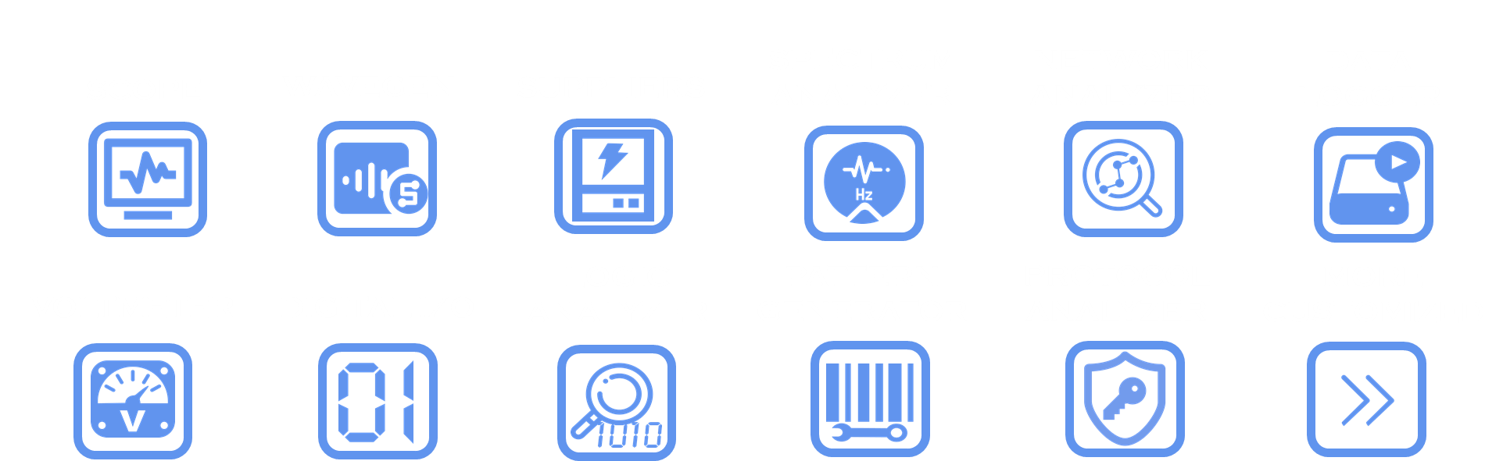

Nigilent
Raindrop
Oscilloscope
2 channels, 12/14-bit resolution, 40/100/125 MS/s, +25V input voltage, up to 30+ MHz bandwidth (with BNC adapter)
User-configurable input filters and phase-locked amplifier
Supports FFT, spectrum analysis, eye diagrams, and XY plots
Waveform Generator
2 channels, 12/14-bit resolution, 40/100/125 MS/s sampling rate, +5V output voltage, up to 12 MHz bandwidth (with BNC adapter)
Features include standard waveforms, amplitude and frequency modulation signals, playback of analog input, custom waveforms, and more.
Logic Analyzer and Pattern Generator
16 channels, with each channel supporting up to 40/100/125 MS/s
Independently configurable 3.3V digital inputs and outputs, with a maximum input of 5V
Supports SPI, I2C, UART, and custom protocols.
Programmable Power Supply
Variable power supply ranging from 0.5V to 5V and -0.5V to 5V
Each channel can provide up to 800mA when using auxiliary power.
Additional Features
Spectrum analyzer, network analyzer, impedance analyzer
Protocol analyzer, virtual digital I/O (buttons, switches, LEDs)
Data logger, voltmeter, scripting capabilities, expandable to include a digital multimeter (measuring capacitance, resistance, voltage, current).

Slide 41
Closed-loop Experiential Education (Test)
Competition: How to Win a Raindrop To Aid Your Testing?
Learning Objectives:
Participants construct experiments using a breadboard and off-the-shelve components.
Nigilent-created video modules
Participants are to complete all modules and answer quiz questions.
Competition:
Each team is to prepare a teaching lesson (consisting of multiple short videos and quiz questions showing rigorous testing) on the testing methodology of their chip
Each participant is to write a testimonial on their experience with overall UNIC-CASS and testing experience using Raindrop3 in chip testing.
Certification:
Nigilent will issue certificate to the students completing this program in recognizing the proficiency/competencies in using Raindrop3 for chip testing

Slide 42
  For more information and to join CASS, visit:
  IEEE-CAS.ORG

