Slide 1


UNIC-CASS Design-to-Tapeout Mentoring
Universalization in IC Design by CASS (UNIC-CASS)
Meet-up #3 ( Sept 6th, 2023 )
Welcome to : Students
Mentors
CASS Volunteers IC Professionals
Sept 6th, 2023, 09:00am EDT (UTC-4)
Moderators: Sergio Bampi & Jorge Marin

Slide 2
Meet-up #1 Agenda
9.00-9.15: Welcome & Today´s agenda ( Sergio Bampi & Jorge Marin, Team leads)
9:15-10:15: “Introduction to the Analog Design Flow"
by Jorge Marin (Univ. F. S. M. , Chile) and Alfonso Cortez
10:15-10:30 Q&A and Suggestions by all mentors
10:30 : Adjourn

Slide 3
UNIC-CASS thanks to:
Molly Brackin at Conference Catalysts for her support
All previous mentoring sessions are at the
UNIC-CASS homepage https://ieee-cas.org/universalization-ic-design-cass-unic-cass

Slide 4
UNIC-CASS Program Overview

Slide 5
Universalization in IC Design by CASS
(UNIC-CASS)
For more information, visit: https://ieee-cas.org/universalization-ic-design-cass-unic-cass
What is UNIC-CASS?
A structured end-to-end Integrated Circuit (IC) design-to-test experiential learning program. strategic cooperation with the SSCS serving geographical-complementing locations.
Aim:
To improve the know-how and accessibility to IC Design technologies for enthusiasts and design communities worldwide
How it works?
      Learn: Jumpstart your journey from carefully curated materials on CASS MiLe platform
      Design: Hands-on design mentoring by experts in the field,
      Fabricate: Submit designs to CASS-sponsored fabrication runs via Efabless chipIgnite program
      Test: “Bringup” your fabricated chip at selected testing facilities.
Benefits:
Learn by experience from IC to chip test/bring-up.
Discover using open-source EDA tools and Open PDKs.
Enhance students' professional careers
Material available in GitHub ( github.com/unic-cass ), slack channel (https://unic-cass.slack.com/ ), CASS Microlearning (https://ml.ieee-cas.org)
Notes:
What is UNIC-CASS (Aim, Synergy with SSCS, Benefit)
UNIC-CASS Calendar
The program (Education, Mentoring, Chip bringup)
2023 UNIC-CASS submission
Whos’ who in UNIC-CASS

Slide 6
UNIC-CASS Milestones - 2023
Date | Activity
June 22nd | First Call for Participation
July 28th | Deadline for Students Proposal submission
Aug 17th | WW UNIC-CASS Webinar (world-wide) – Stream from CASS Resource Center
Aug 18th | Announcement : 27 Design teams Selected
Aug 23rd – Oct 30 | Design-to-Tapeout Mentoring sessions Learn from specially curated educational materials
Sept 22 | Mock-tapeou t DELIVERABLES by the Design TEAMS
Nov 6, 2023 | Efabless Deadline for Clean & Top-level layout submission
April 2024 | Start Chip test/bring-up

Slide 7
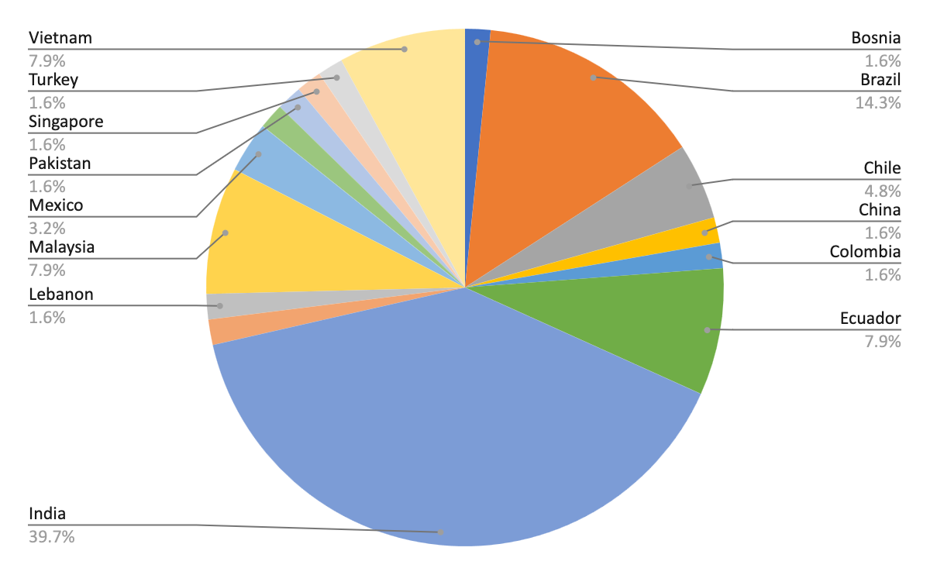
2023 UNIC-CASS submissions
68 Team Proposals 16 Countries

Slide 8
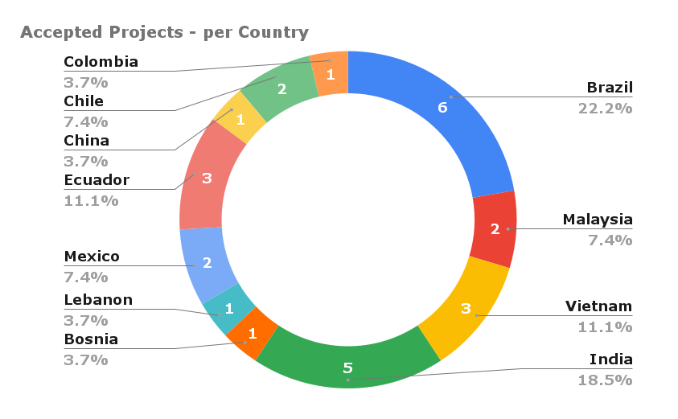
2023 UNIC-CASS Selected Design Teams
@Start line : 27 Teams 11 Countries
Latin America: 14
Far East: 11
Region 8 : 2

Slide 9
Whos’ who in UNIC-CASS
Project Sponsor: Jose De La Rosa (University Sevilla, Spain)
Education Team
Duy-Hieu Bui (Lead), Vietnam National University (Lead)
M. B. Ghaznavi-Ghoushchi, Shahed University Iran
Dimitri Galayko, Sorbonne Université France
Noor Ain Kamsani, Universiti Putra Malaysia
Suhaidi Shafiee, Universiti Putra Malaysia
Mohd Amrallah Mustafa, Universiti Putra Malaysia
Lini Lee, Multimedia University Malaysia
Azrul Ghazali, Universiti Tenaga Nasional Malaysia
Haslina Jaafar, Universiti Putra Malaysia
Design-to-Tapeout Mentoring
Sergio Bampi (Lead), UFRGS Brazil
Rodrigo N. Wuerdig, UFRGS Brazil
Jorge Marin, UTFSM Chile
Fernando Silveira, Universidad de la República Uruguay
Pablo Petrashin, Universidad Católica de Córdoba Argentina
Victor Grimblatt, Synopsys Chile
Ricardo Reis, UFRGS Brazil
Sahil Shah, University of Maryland USA
Nicole McFarlane, University of Tennessee USA
Aloke Das, Alten Calsoft Labs India
Miguel Corvacho, Intel USA
Chip Test/Bring-up
Yongfu Li (Lead), Shanghai Jiao Tong University, China
Rajesh Chandrasekhara, National Unviersity of Singapore
Qi Liang, Shanghai Jiao Tong University, China
Xiaochen Tang
Xinfei Guo, New Mexico State University USA

Slide 10

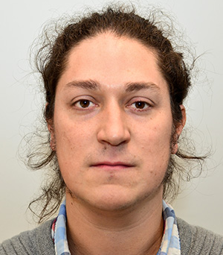
UNIC-CASS Design-to-Tapeout
Meet up organizers
Sergio Bampi
Federal Univ. of Rio Grande do Sul, Brazil
Jorge Marin
Univ. Tecnica Federico Santa Maria, Chile

Slide 11
Design-to-Tapeout activities schedule I
Activities | Date/ Deadline | Purpose | Your Deliverables (provide info/links on your GitHub)
WW Webinar | Aug 17, 2023 | UNIC-CASS Introduction & WW Webinar
Weekly meet-ups | Aug 23, Aug 30, Sep 6, Sep 13, Sep 20 | Mentoring and Design groups to present progress. Invite short presentations on topics such as Caravel/Caravan, best practices, pitfalls to avoid. Invited talks. eFabless, Digital Flow, Analog Flow , Pitfalls on Schematics, Pitfalls on custom-layout. |  | Kick-off with the selected Design Teams.
1st Design submission [Mock tapeout] | Sept 22 |  | TBD | 1. Merge designs 2. Run local pre-checks
1st Design Review & Feedback | Sept 29 |  |  | Feedback on the “merge-run pre-check”

Slide 12
Design-to-Tapeout activities schedule II
Activities | Date/ Deadline | Purpose | Your Deliverables (provide info/links on your GitHub) | We will provide/handle
Weekly meet-ups | Oct 4, Oct 11 | Guide to final submission and solve teams’ issues. | A check-list of to-dos to the Design Teams. Evaluate status of potential “drop-outs”.
2nd Design submission | Oct18 |  | TBD | Check all blocks are LVS, DRC clean.
2nd Design Review & Feedback | Oct 22 |  | Maybe a 1-week extension for late bugs detected | Delivery by Design teams of their finished blocks in GDSII.
eFabless pre-check | Nov 3 |  | Deliver 2 Caravelle drop-ins to e-Fabless to check
Tape-out | Nov 6 | Finish line! |  | List of “winner teams” included in this Tapeout. List of unfinished Designs to candidate for April, 2024 UNIC-CASS Call

Slide 13
Design-to-Tapeout mentoring activities
Aug 23: Introduction to Efabless Caravel/Caravan harness
Aug 30: Introduction to the digital design flow
Sep 6: Introduction to the analog design flow
Sep 13: Best practices and pitfalls in digital design
Sep 20: Best practices and pitfalls in analog design

Slide 14
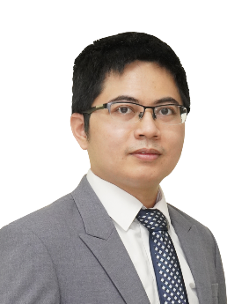
UNIC-CASS Education
Presented by:
Duy-Hieu Bui
Information Technology Institute,
Vietnam National University, Hanoi

Slide 15
UNIC-CASS Education Introduction
Main roadblocks for
Design & Education
UNIC-CASS companion course:
Integrated Circuit Design using Open-Source Tools and PDKs
A Jumpstart with opensource tools & PDKs
Cultivated Videos with updated lecturer notes for current PDKs & tools
Simplifying EDA tool & PDK installation
Open MPW or Chip Ignite fabrication
Guidelines & design examples
Learning path for Digital & Analog
ASIC
RTL/IP libraries
PDK Data
EDA Tools

Slide 16
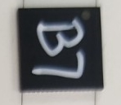
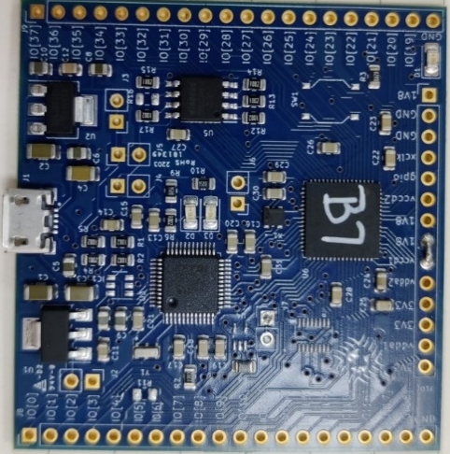
Example: Design a chip in less than 3 months
VCO-based ADC example: mixed-signal design from scratch
Made possible by Opensource EDA tools & Open PDKs
early, 2021
April, 2021
June 18, 2021
June 24, 2021
Feb., 2022
Heard about Google Open MPW & got intereted
Call for Google Open MPW-2 submission
Form a team & decided to submit VCO-based ADC
Submit the design for Google Open MPW
Get sponsored by SSCS PICO program
Receive the chips & testboard
Project repository: https://github.com/duyhieubui/caravel_vco_adc

Slide 17
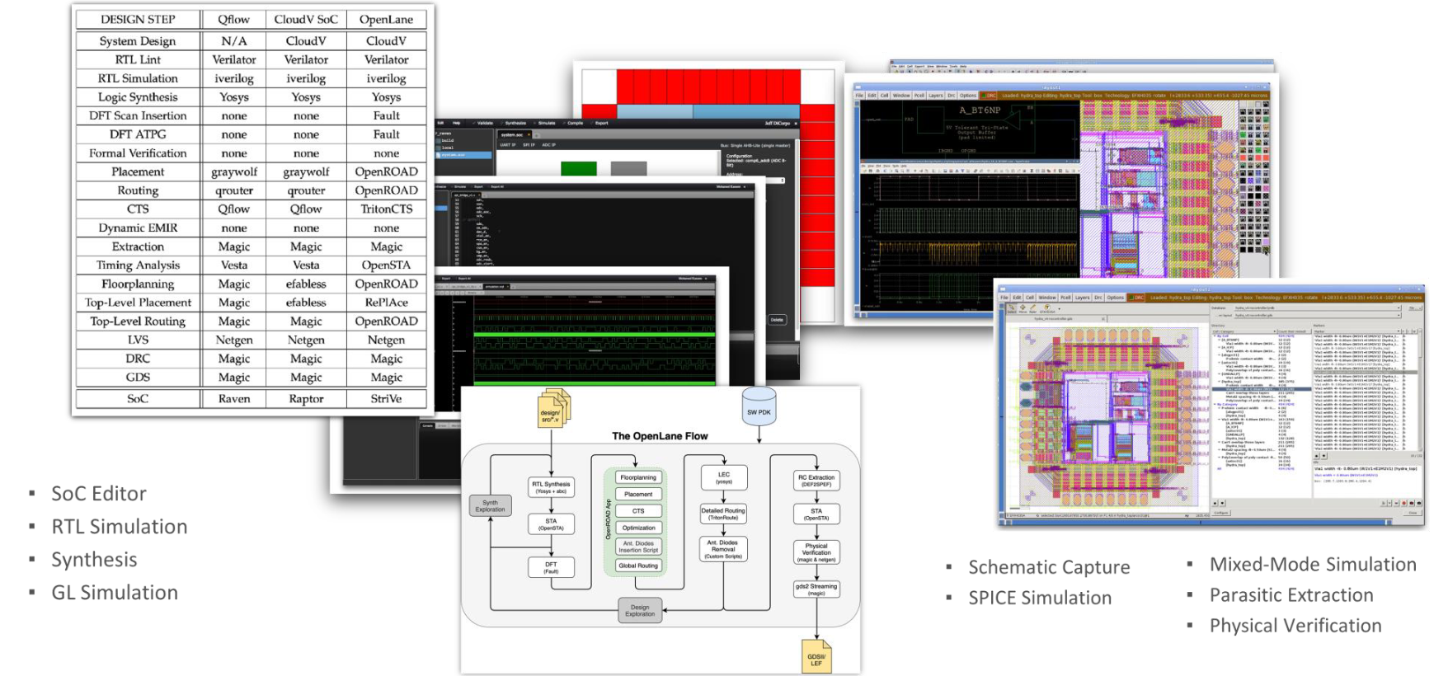
Open SoC Design flows & tools
Source: Boris Murmann

Slide 18
Open PDKs
Open-source PDK repository
Standardizing open-source PDKs for Open-source tools
Skywater 130 PDK
  sky130_fd_sc/pr
  Standard cells: hd, hdll, hvl, hs, ms, ls, lp
  IO cells, SRAM bitcells, SONOS Flash bitcells
  SRAM compiler (opensource)
  ReRAM supports
Global Foundry 180MCU
Open PDKs’ Makefile & scripts
XSchem
…
Magic
Openlane
NGSpice
KLayout

Slide 19
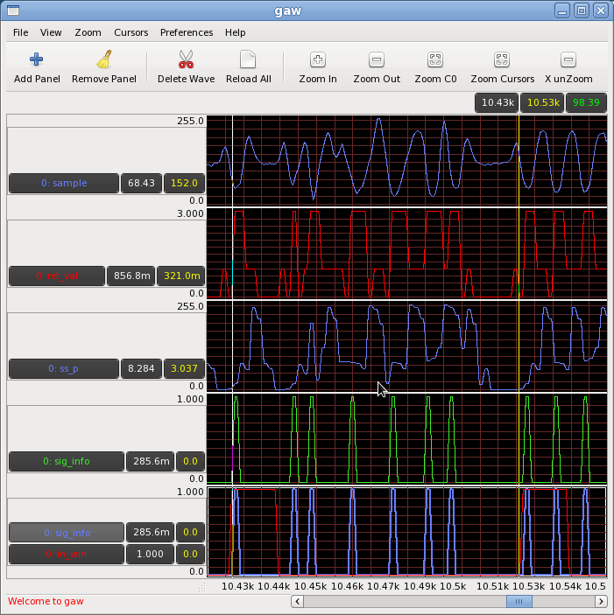
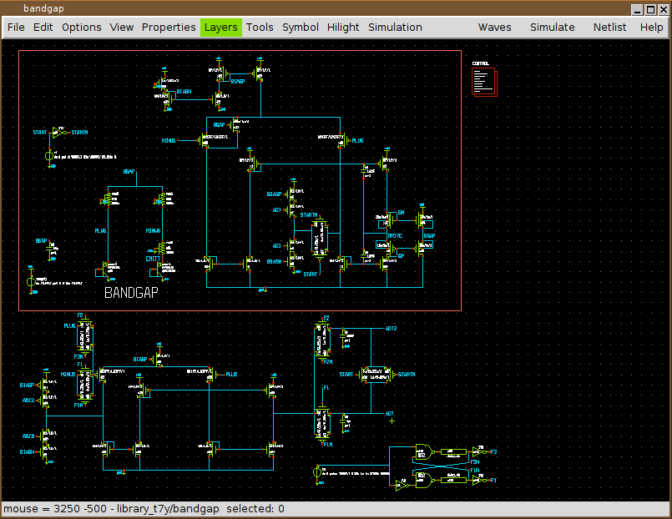



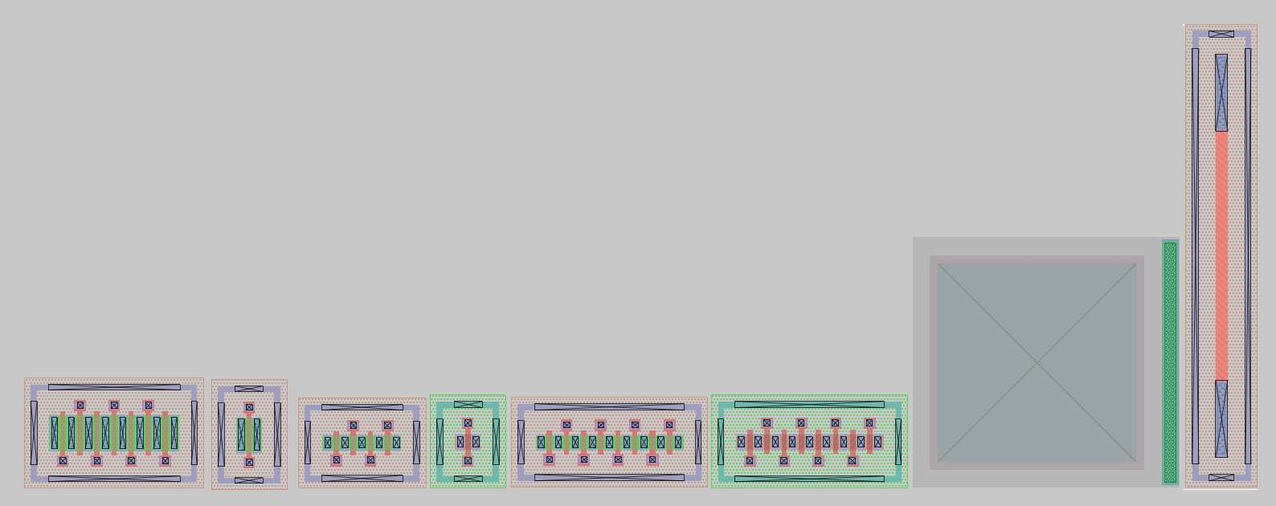
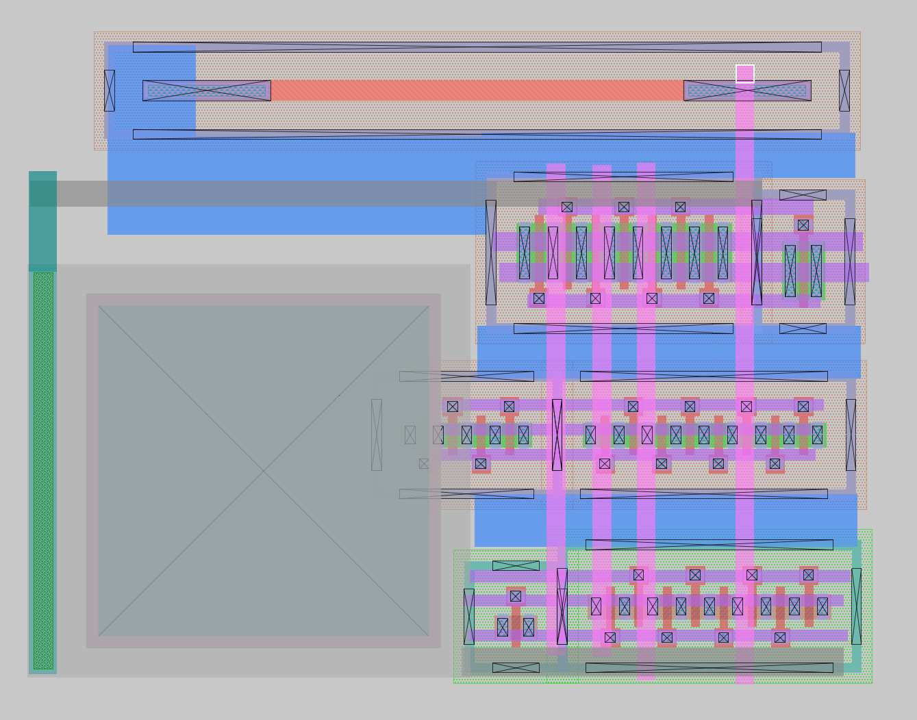
Analog design flow
Netlist
export
Simulate
view
Schematic capture
Ngspice
database
Xschem
Gaw
Generate & Import netlists into Magic
Evaluation & debugging
Layout Vs schematic
Netgen
Pass/fail?
Gaw
export
Simulate
view
Layout & DRC
Ngspice
Netlist
database
Magic

Slide 20
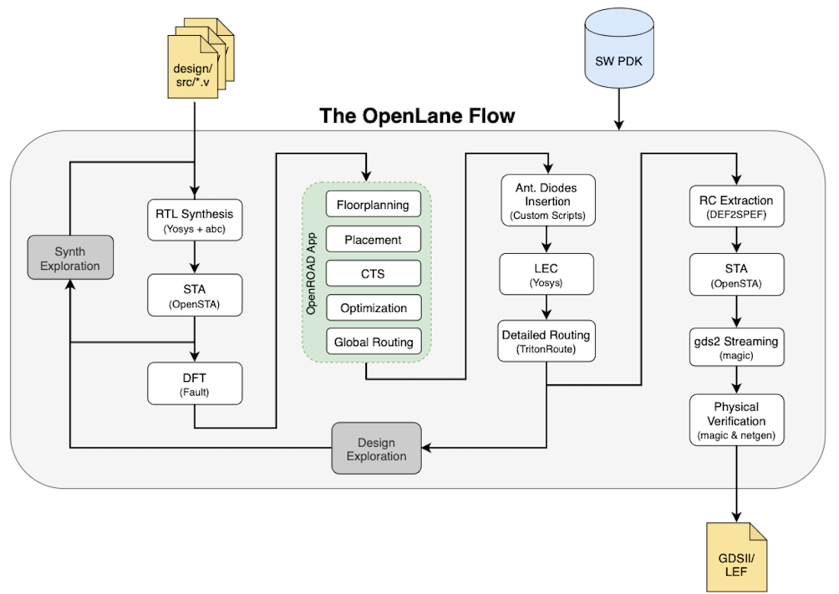
Digital Design flow: RTL-to-GDS
Tool used:
Yosys: synthesis
OpenSTA: timing analysis
Fault: DFT (on-going)
OpenRoad: Backend
Magic/Klayout:
  Layout manipulation
  Debugging
Netgen: LVS

Slide 21
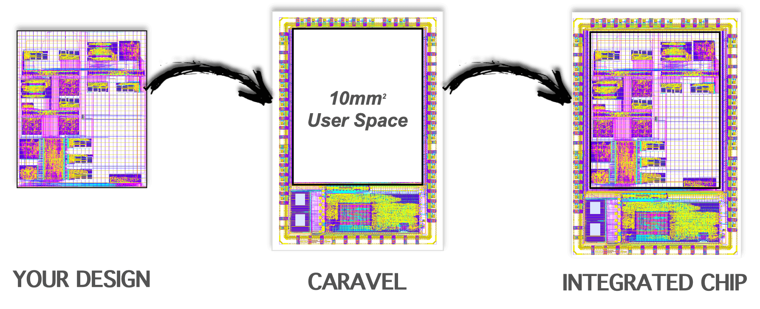
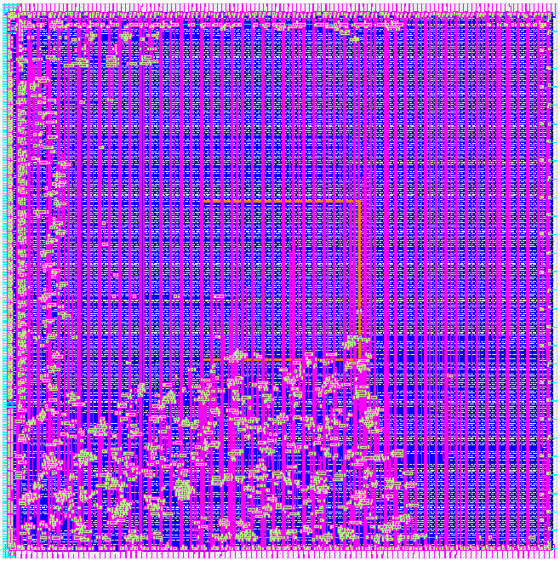
Open MPW/Chip Ignite design focus
Your design
Caravel user project
Wrapper
Harden your design
Integrate your design into user project wrapper
Caravel test harness
Integrated Chip
Run STA &
precheck scripts
Submit your design
& run tapeout jobs
(Efabless server)

Slide 22

Course outline & learning path
Digital Design
Analog Design
1. Course introduction
2. Tool installation & env setup
2.1 Digital design tools using docker
2.2/2.3 AMS design tools on Docker/conda
4. Digital Design flow with Opensource tools
3. Analog design flow with Opensource tools
5. Functional verification (with Caravel)
6. Preparing design for Tapeout
7. Design examples
7.2 Comparator (design & simulation)
7.3 Operational Amplifier (Layout)
7.4 Layout techniques in Magic
7.1 Basic digital design with Caravel
7.6 OpenRAM compiler

Slide 23




UNIC-CASS
Lecture organization
Each lesson contains (either or both):
Lecture videos
          Cultivated from the public source
          Demonstrate the ideas & steps to execute
Lecturer notes
          Updated materials with current design flows & tools
⇒Linking among methodologies, design flows and tools

