Slide 1
UNIC-CASS Design-to-Tapeout Mentoring
Universalization in IC Design by CASS (UNIC-CASS)
Meet-up #8 ( Oct 11th, 2023 )
Welcome to : Students
Mentors
CASS Volunteers IC Professionals
Oct 11th, 2023, 09:00am EDT (UTC-4)
Moderators: Sergio Bampi & Jorge Marin

Slide 2
Meet-up #8 Agenda
9.00-9.05: Welcome & Review Today´s agenda
9:05 : 9:10 Review Tapeout Milestones ( Sergio Bampi) (Federal Univ. UFRGS, Brazil)
9:15 : 9:30 Feedback to DTs / Replies to https://forms.gle/nZhxgzKGLrbCr4HD8
9:30 : 9:40 Four IC from UNICASS - Summary
9:40 – 9:50 Volunteers for Top-Level ICs
9:50-10:15 Q&A by Design Teams and Suggestions by all mentors
10:15: Adjourn

Slide 3
UNIC-CASS thanks to: Molly Brackin at Conference Catalysts for her support behind the scenes All previous mentoring sessions are recorded and available at the UNIC-CASS homepage https://ieee-cas.org/universalization-ic-design-cass-unic-cass

Slide 4
UNIC-CASS Program Overview

Slide 5
Universalization in IC Design by CASS (UNIC-CASS)
https://ieee-cas.org/universalization-ic-design-cass-unic-cass
What is UNIC-CASS?
A structured end-to-end Integrated Circuit (IC) design-to-test experiential learning program. strategic cooperation with the SSCS serving geographical-complementing locations.
Aim:
To improve the know-how and accessibility to IC Design technologies for enthusiasts and design communities worldwide
How it works?
Learn: Jumpstart your journey from carefully curated materials on CASS MiLe platform
Design: Hands-on design mentoring by experts in the field,
Fabricate: Submit designs to CASS-sponsored fabrication runs via Efabless chipIgnite program
Test: “Bringup” your fabricated chip at selected testing facilities.
Benefits:
Learn by experience from IC to chip test/bring-up.
Discover using open-source EDA tools and Open PDKs.
Enhance students' professional careers
Material available in GitHub ( github.com/unic-cass ), slack channel (https://unic-cass.slack.com/ ), CASS Microlearning (https://ml.ieee-cas.org)
Notes:
What is UNIC-CASS (Aim, Synergy with SSCS, Benefit)
UNIC-CASS Calendar
The program (Education, Mentoring, Chip bringup)
2023 UNIC-CASS submission
Whos’ who in UNIC-CASS

Slide 6
UNIC-CASS Milestones - 2023
Date | Activity
June 22nd | First Call for Participation
July 28th | Deadline for Students Proposal submission
Aug 17th | WW UNIC-CASS Webinar (world-wide) – Stream from CASS Resource Center
Aug 18th | Announcement : 27 Design teams Selected
Aug 23rd – Oct 30 | Design-to-Tapeout Mentoring sessions Learn from specially curated educational materials
Sept 22 | Mock-tapeou t DELIVERED by 16 Design TEAMS (DTs)
Oct 3rd | DTs finished their Design Reviews
Oct 18th | 2nd Design submission to eFabless - DRC and LVS checks
Oct 22 | Complete a major Design Review with local Mentor
Nov 6, 2023 | Efabless Deadline for Clean & Top-level layout submission
April 2024 | Start Chip test/bring-up

Slide 7
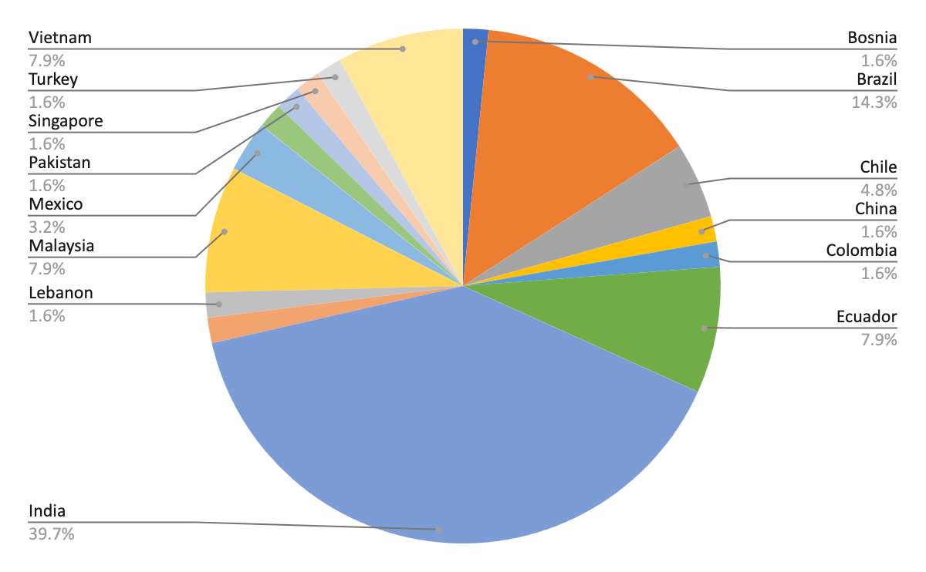
2023 UNIC-CASS submissions 68 Team Proposals 16 Countries

Slide 8
2023 UNIC-CASS Selected Design Teams @Start line : 27 Teams 11 Countries
Latin America: 14
Far East: 11
Region 8 : 2

Slide 9
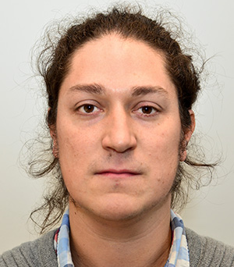
UNIC-CASS Design-to-Tapeout
Meet up organizers
Sergio Bampi
Federal Univ. of Rio Grande do Sul, Brazil
Jorge Marin
Univ. Tecnica Federico Santa Maria, Chile

Slide 10
Design-to-Tapeout activities schedule I
Activities | Date/ Deadline | Purpose | Your Deliverables (provide info/links on your GitHub)
WW Webinar | Aug 17, 2023 | UNIC-CASS Introduction & WW Webinar
Weekly meet-ups | Aug 23, Aug 30, Sep 6, Sep 13, Sep 20 | Mentoring and Design groups to present progress. Invite short presentations on topics such as Caravel/Caravan, best practices, pitfalls to avoid. Invited talks. eFabless, Digital Flow, Analog Flow , Pitfalls on Schematics, Pitfalls on custom-layout. |  | Kick-off with the selected Design Teams.
1st Design submission [Mock tapeout] | Sept 22 |  | Disclosed on Sept 13 | 1. Merge designs 2. Run local pre-checks
1st Design Review & Feedback | Sept 29 | Done with STUDENTS and their respective LOCAL MENTOR |  | Feedback on the “merge-run pre-check”, Design Progress

Slide 11
Design-to-Tapeout activities schedule II
Activities | Date/ Deadline | Purpose | Your Deliverables (provide info/links on your GitHub) | We will provide/handle
Weekly meet-ups | Oct 4, Oct 11 | Guide to final submission and solve teams’ issues. | A check-list of to-dos to the Design Teams. Evaluate status of potential “drop-outs”.
2nd Design submission | Oct18 |  | TBD | Check all blocks are LVS, DRC clean.
2nd Design Review & Feedback | Oct 22 |  | Maybe a 1-week extension for late bugs detected | Delivery by Design teams of their finished blocks in GDSII.
eFabless pre-check | Nov 3 |  | Deliver 2 Caravelle drop-ins to e-Fabless to check
Tape-out | Nov 6 | Finish line! |  | List of “winner teams” included in this Tapeout. List of unfinished Designs to candidate for April, 2024 UNIC-CASS Call

Slide 12
Design-to-Tapeout mentoring activities
Oct 11th : Session #8
Oct 18th : Session #9
Oct 25th : Session #10
Deliver GDS-II . DRC, LVS clean for Top-Level IC

Slide 13
Call to action : To all DT Mentors: A) Proceed Design Progress Reviews with your Team - in meeting with the Local Mentor B) DT ready to submit by Oct 25

Slide 14
IC Harness – Assemby of top Level IC1-CASS Digital Only
Mentor | IP BLOCK | Digital I/ Os | Area (mm2) | X times Y (um) (um)
Yang Lim / Malaysia | EGD_top | 35 | O,0068 mm2
Nasri Sulaiman | R4_Butterfly | 43 | 0,06 mm2 | 300 x 200
Joyce Merkie | DNNAcc | 55 | < 5.0 mm2
C. Diniz / R. Wuerdig | ALU32b | 72 | 0.1 mm2
205 Pins

Slide 15
IC Harness – Assemby of top Level IC2-CASS Analog Mixed Signal AMS
Mentor | IP BLOCK | Analog I/Os | Digital I/Os | Area (mm2) | X times Y (um) (um)
Francisco Brito | DPGA | 9 | 4 | 0,03 | 150 x 200
M. Schneider | Cafeina | 10 |  | 0,15 | 200 x 500
Fabian Olivera | GME-Cefet | 9 |  | 0,006 | 70 x 80
Prabhavati | ADLDO | 2 | 3 | 1.3 | 1,100 x 1,100

Slide 16
IC Harness – Assemby of top Level IC3-CASS Analog Mixed Signal AMS
Mentor | IP BLOCK | Analog I/Os | Digital I/Os | Area (mm2) | X times Y (um) (um)
Agustin Gonzalez | BLE | 2 |  | 1.0
Agustin Gonzalez | BGR+TempSensor | 1 | 2 | 0.022 | 130 x 170
Luis Miguel Procel | AgroCHip | 6 | 6 | 0.25 | 500 x 500
Fredy Segura | PLL | 3 | 2 | 1.0 | 1,000 x 1,000
Luis C. Alvarez | PSCM | 8 | 5 | 1.2

Slide 17
IC Harness – Assemby of top Level IC4-CASS Analog Mixed Signal AMS
Mentor | IP BLOCK | Analog I/Os | Digital I/Os | Area (mm2) | X times Y (um) (um)
Tran Thuat | MulColRO | ? | ?? | 3.0
Alexandar Pajknovic | Free DAC | 8 | - | 0.64 | 800 x 800
Ashis Malty | ULQC_LDO | 14 | - | 0,064
Naveen Kadaynti | ClipSafe | 14 | 5 | 1.2
38 5

